Slide 1
Development of In vitro qFRET Reporter Assays for the Characterization of Non-covalent and Covalent Protein-Protein Interaction
Vipul Madahar

Slide 2
Presentation Outline
Introduction to qFRET Technology
In vitro qFRET Based Assay for Interaction of PD1-PDL1
qFRET Based K_{D} and K_{i}
In vitro SUMOylation of IAV-M1 and SARS-CoV-2 Nucleocapsid protein with qFRET as a Reporter

Slide 3
Introduction to qFRET Technology Background and Significance
The lessons learned from proteomic studies
Dynamic behavior of the protein network during disease pathogenesis
Proteins exist as isoforms called proteoforms, from genetic or RNA variations, and post translation modification that modulate the proteins' function and interaction network
Example of Covalent Modifications
Ubiquitination - Lysine
Phosphorylation - S/T/Y/H
NEDDylation - Lysine
SUMOylation - Lysine
Acytlation/Methylation/Glycosylation
Proteoform 1
Proteoform 2
Proteoform 3
Proteoform 4
Proteoform n

Slide 4
Introduction to qFRET Technology Background and Significance
Cellular Function
Translocation
*Phosphorylation
Disease Progression
Protein-Protein Interaction
K_{D}, k_{cat}, K_{m}
Protein Isoforms
Transcription Regulation
Immune Response
Protein Secretion
Protein Life Cycle
*Ubiquitin

Slide 5
Introduction to qFRET Technology Background and Significance
The next step in understanding our proteome network is to investigate the dynamic properties of our proteome and to resolve covalent and non-covalent interactions
The bottle neck in establishing a dynamic interaction network are challenges in identifying modified proteins (proteoforms) and characterizing the kinetic parameters of protein-protein interaction

Slide 6
Introduction to qFRET Technology Background and Significance
Quantitive Förster Resonance Energy Transfer (qFRET) platform provides a robust method to monitor the protein-protein interaction events
Liao Lab we have developed several methods for quantifying protein-protein interaction using FRET principles
Application | Year Est. | Alumni
K_{D} | 2011 | Yang Song
P-P Interaction HTS | 2012 | Yang Song
k_{cat}/K_{M} | 2011 | Yan Liu
K_{i} | 2016 | Michael Xiong*
K_{D} (Without Purification) | 2019 | Ling Jiang & Michel Xiong*

Slide 7


Introduction to qFRET Technology Background and Significance
Förster Resonance Energy Transfer describes the non-radiative dipole-dipole interaction between the donor and accepter pairs
Theodor Förster characterized the phenomenon and found that the dipole-dipole coupling occurred within 1 – 10 nm, R, the distance between donor and acceptor
This phenomenon is highly sensitive to the distance R between donor and acceptor due to the inverse sixth power relationship to efficiency
$$FRET Efficiency: E=\frac{R_{0}^{6}}{R_{0}^{6}+R^{6}}$$
$$\text{F}\text{ö}\text{rster} Distance: R_{0}^{6}=0.021∗κ^{2}∗n^{−4}∗{\text{Φ}}_{D}∗J$$
Spectral Overlap: $J=\int{\overline{I_{D}}∗∈_{A}∗λ^{4}∗dλ}$
Notes:
$$\text{F}\text{ö}\text{rster} Distance$$
Spectral Overlap

Slide 8
Introduction to qFRET Technology Background and Significance
Applied here are two fluorescent proteins that have been optimized for FRET
CyPet (donor) –YPet (acceptor) are observed to have a 20-fold higher FRET efficiency then the CFP-YFP pair, with an observed R₀ of 5.15 nm
Acceptor YPet
Predicted FRET efficiency over distance R
Donor Cypet

Slide 9
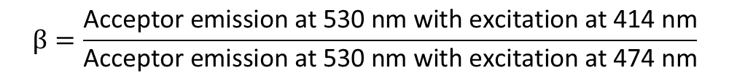
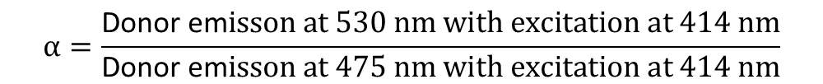
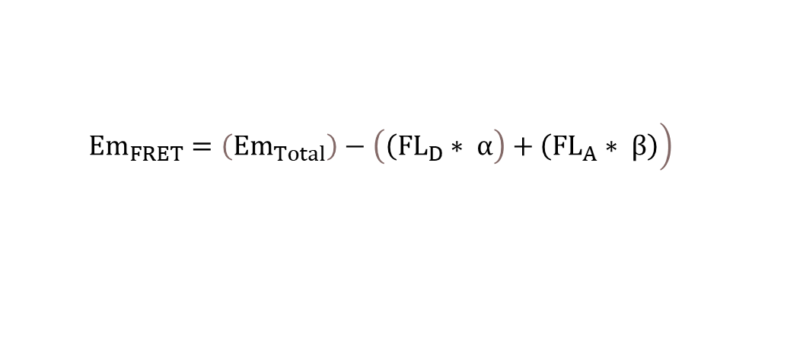
Introduction to qFRET Technology Background and Significance
Bulk FRET reporter, Em_{FRET}, is measured by observing three wavelengths
We correct for cross talk using two ratiometric parameters alpha α and beta β
 | Excitation (λ) | Emission (λ)
Em_{Total} | 414 nm | 530 nm
Fl_{D} | 414 nm | 475 nm
FL_{A} | 475 nm | 530 nm
$$\left.{Em}_{FRET}=\left({Em}_{Total}\right)−\left(\left({FL}_{D}∗ α\right.\right)+\left({FL}_{A}∗ β\right)\right)$$
$$α=\frac{\text{Donor} \text{em}isson at 530 nm with excitation at 414 nm}{\text{Donor} \text{em}isson at 475 nm with excitation at 414 nm}$$
$$β=\frac{\text{Acceptor} \text{emission} \text{at}\text{ 530 }\text{nm} \text{with} \text{excitation} \text{at}\text{ 414 }\text{nm}}{\text{Acceptor} \text{emission} \text{at}\text{ 530 }\text{nm} \text{with} \text{excitation} \text{at}\text{ 474 }\text{nm}}$$

Slide 10
Introduction to qFRET Technology Background and Significance
Technique | Surface Plasmon Resonance (SPR) | Isothermal Titration Calorimetry (ITC) | Quantitative Förster Resonance Energy Transfer (qFRET)
Advantages | Sub nanomolar detection - Resolve K_{D}/K_{i} | - Solubilized - No tag required - Resolve K_{D}/K_{i}/kcat/K_{m} | Solubilized Resolve K_{D}/K_{i}/k_{cat}/K_{m} HTS Compatible
Disadvantages | - Immobilization - Protein modification - Specialized instrument | - High concentration of protein required - Specialized instrument | -Fluorescent tag required

Slide 11
Presentation Outline
Introduction to qFRET Technology
In vitro qFRET Based Assay for Interaction of PD1-PDL1
qFRET Based K_{D} and K_{i}
In vitro SUMOylation of IAV-M1 and SARS-CoV-2 Nucleocapsid protein with qFRET as a Reporter

Slide 12
Development of qFRET based interaction assay of Programmed Death 1 (PD1) and Programmed Death Ligand 1 (PDL1)

Slide 13
PD1-PDL1 Interaction a Target for Cancer Therapy
Cancer Cell
Cancer Cell
Anti-PDLs
MHCI
PDL1
PD1
C8
Anti-PD1
Cytokine release inhibited
TCR
SHP-2
Cytokine release
Cytotoxic T-Cell
Cytotoxic T-Cell
Notes:
Figure 1: The interaction of PD1 with PDL1 or 2 exhausts the T-Cell response and allows the cancer cells to survive. The T cell surface receptor contacts the major histocompatibility complex I surface protein. The PD1 also interacts with the PDL1 protein, and the downstream signaling by TCR is inhibited by the recruitment of SHP-2. In contrast to when PD1 does not interact with PDL1 or 2 the SHP-2 is not recruited and does not inhibit the TCR response. B.) The anti-PD1 or anti-PDL mAbs block PD1 and PDL from interacting. PD1 can no longer recruit SHP-2 and the T-Cell activates to destroy the cancer cell.
Programmed Death 1 (PD1) is a membrane protein that is expressed on immune cells such as T cells
T cell interaction with antigen presenting cells (APC) will initiate an immune response
Programmed Death Ligand 1 (PDL1) is expressed on APC to exhaust the immune response
The interaction of PD1 with PDL1 completes the “immune checkpoint” and inhibits the immune response

Slide 14
PD1-PDL1 qFRET Assay Principle and Design
qFRET based assay design to investigate non-covalent interaction
FRET
PD1
PDL1
Acceptor
Donor
CyPet-Programmed Cell Death Receptor 1
YPet-Programmed Cell Death Ligand 1
Notes:
Introduced here

Slide 15

qFRET dissociation constant (K_{D}) Resolving qFRET based disassociation constant K_{D}
K_{D} is a metric used to evaluate the non-covalent interaction of two biomolecules
We derive a relationship of Em_{FRET} with K_{D}
Given the following interaction scheme
K_{D}
$$K_{D} \text{=}\frac{\text{[}\text{R}\text{]}\text{Free}\text{∗}\text{[}\text{L}\text{]}\text{Free}}{\text{[}\text{RL}\text{]} }$$
[R]+[L]
[RL]
$${Em}_{FRET}={Em}_{FRET}\text{M}\text{a}\text{x}∗(\frac{\left[L\right]Total−\left[R\right]Total−K_{D}+\sqrt{{(\left[R\right]Total+K_{D}−\left[L\right]Total)}^{2}+4∗K_{D}∗\left[L\right]Total}}{\left[R\right]Total+K_{D}−\left[L\right]Total+\sqrt{{\left(\left[R\right]Total−\left[L\right]Total+K_{D}\right)}^{2}+4∗K_{D}∗\left[L\right]Total}})$$ | Eq. 2.16
Manuscript: Development of qFRET assay for PD1-PDL1 interaction
Patent Disclosure: Neutralizing Antibody Assay (7/2021)

Slide 16
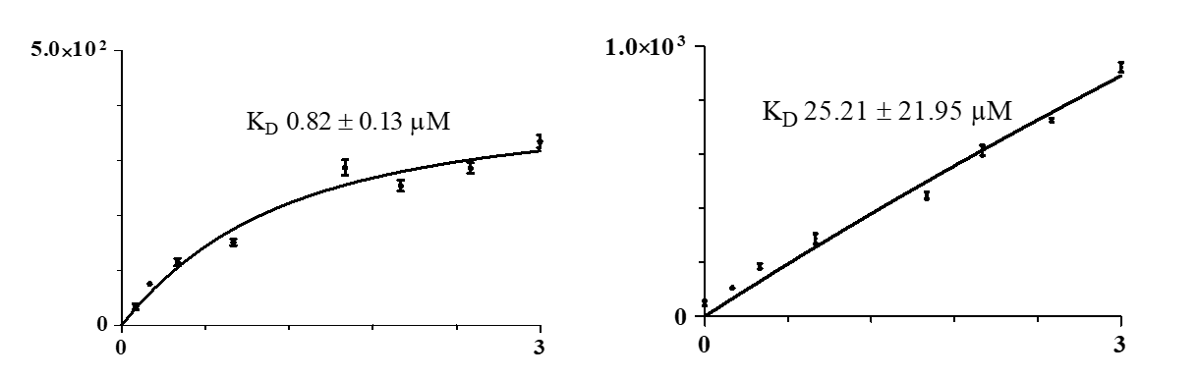
Results qFRET based K_{D} Protein Isolated From Soluble Fraction
 | CyPet-OptPD1-YPet-OptPDL1 | Negative Control: CyPet-OptPD1-YPet
K_{D} (µM) | 0.82 | 25.21
Std. Error (µM) | 0.13 | 21.95
95% Confidence Intervals (µM) | 0.55 to 1.07 | 0.0 to 70.73
R² | 0.97 | 0.98
EmFRET (R.F.U.)
EmFRET (R.F.U.)
Total YPet-OptPDL1 (µM)
Total YPet (µM)
Manuscript: Development of qFRET assay for PD1-PDL1 interaction
Patent Disclosure: Neutralizing Antibody Assay (7/2021)
Notes:
Figure 3:Kd measurement was done with CyPet-OptPD1 held constant at 0.2 µM and titration of the YPet-OptPDL1 from 0 – 3.0 µM. The extracted EmFRET was plotted against the titration of total YPet-OptPDL1. The derived relationship of EmFRET to the total receptor concentration, total ligand concentration, and the Kd from equation 16 is used for non-linear regression and the estimation of a Kd value is shown. GraphPad Prism 5TM is used for the non-linear regression curve fit solution.

Slide 17
Results qFRET based K_{i} Full length PD1 and PDL1 with Pembrolizumab
qFRET Competition Assay: Pembrolizumab
qFRET K_{i} nM | 1.41
95 % Confidence Interval nM | 0.94 to 2.14
R² | 0.97
qFRET IC₅₀ nM | 1.76
95 % Confidence Interval nM | 1.17 to 2.66
R² | 0.97
Manuscript: Development of qFRET assay for PD1-PDL1 interaction
Patent Disclosure: Neutralizing Antibody Assay (7/2021)

Slide 18
Summary of Dissociation Constants Reported For PD1-PDL1
Comparison of qFRET based dissociation constant K_{D}
Flow C. µM | SPR µM | ITC µM | BLI µM | qFRET µM | Exp. Host | Domain | Post Mod.
0.526 | 0.114 | - | - |  | Human Jurkat Cells | External Domain | Amino Coupling
- | 0.77 | - | - |  | COS Cells | External Domain | Amine Coupling
- | 8.2 | 2.2 | - |  | E. coli BL21(DE3) | External Domain | Biotinylated
- | - | - | 4.1 |  | Human Expi293F | External Domain | Amine Coupling
 |  |  |  | 0.82 ± 0.13 | E. coli BL21(DE3) | Full Length | Protein Tag

Slide 19
Challenges In Expression Of PD1 and PDL1 Within E. coli
Low yields in full length and truncated protein expression
Expression and codon optimization of full length OptPD1 and OptPDL1
Refolding external domain and full length OPtPDL1

Slide 20
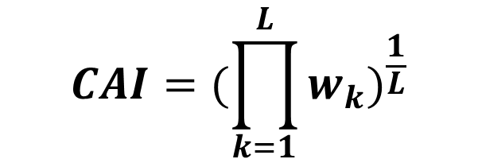
Codon Optimization
Codon Adaptation Index – (CAI) is a overall metric of a genes use of codons in reference to a codon RSCU
CAI value is calculated for a gene, given a relative adaptiveness for codon usage
Geometric mean of relative adaptiveness (w) of a codon from the start codon to the stop codon
Using R-BioConductor Package – developed codon optimization script to optimize for E coli BL21(DE3)
 | CAI Score Human | CAI Score E. coli Wildtype | CAI Score E. coli Optimized
hPDL1 | 0.7 | 0.6 | 0.9
hPD1 | 0.8 | 0.6 | 0.9
$${CAI=(\prod_{k=1}^{L}{w_{k}})}^{\frac{1}{L}}$$
Paul M.Sharp1-2* and Wen-Hsiung Li2, “The codon adaptation index - a measure of directional synonymous codon usage bias, and its potential applications”, Nucleic Acid Research, 15, 1987
Notes:
RSCU

Slide 21
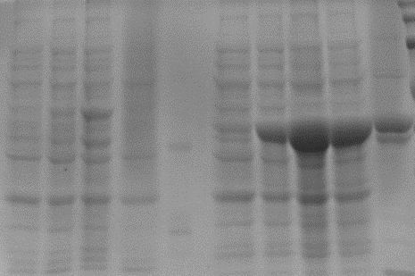
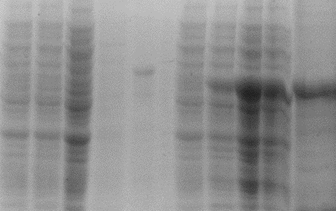
Challenges In Expression Of PD1 and PDL1
His-Tag Purified
His-Tag Purified
His-Tag Purified
His-Tag Purified
Un-Induced
Un-Induced
Un-Induced
Un-Induced
Soluble Fraction
Soluble Fraction
Soluble Fraction
Soluble Fraction
Insoluble Fraction
Insoluble Fraction
Insoluble Fraction
Insoluble Fraction
Induced
Induced
Induced
Induced
Wild Type | Codon Optimized
CyPet-PD1
Wild Type | Codon Optimized
YPet-PDL1
 | Wild Type (ug for a Liter of 2xYT) | Codon Optimized (ug for a Liter of 2xYT) S.F.
CyPet-PD1 (60kD) | 81 | 1820
YPet-PDL1 (64kD) | 1.14 | 1300
Manuscript: Development of qFRET assay for PD1-PDL1 interaction

Slide 22
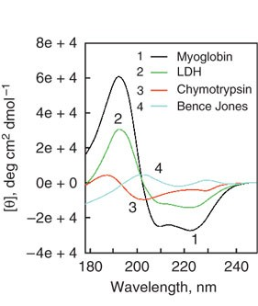
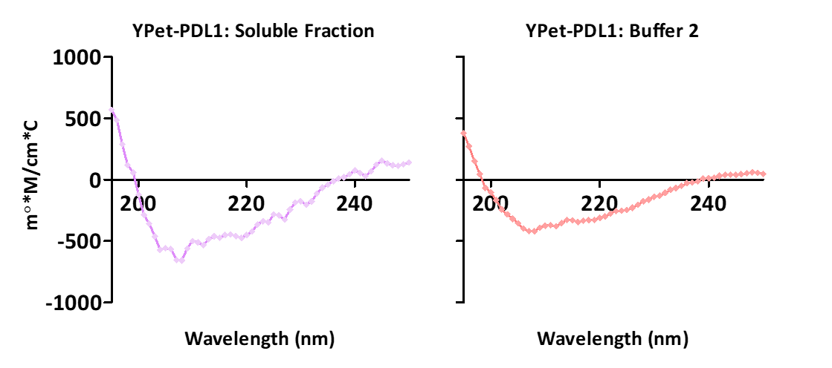
Refolding full length hPDL1 For qFRET Assay Results: Buffer Screen Circular Dichroism (CD)
CD comparison of buffers 1, 2, and 3 show a secondary structure
In comparison to the soluble fraction, we find the same inflection at 210 nm
Manuscript: Development of qFRET assay for PD1-PDL1 interaction

Slide 23
Results qFRET based K_{D} Refolded Full length PDL1
 | Soluble Fraction | Refolded PDL1 | YPet-ExtPD1 and CyPet-ExtPDL1
Kd (µM) | 0.82 | 0.79 | 1.20
Std. Error (µM) | 0.13 | 0.16 | 0.20
95% Confidence Intervals (µM) | 0.55 to 1.07 | 0.46 to 1.12 | 0.77 to 1.63
R² | 0.97 | 0.96 | 0.98
EmFRET (R.F.U.)
EmFRET (R.F.U.)
EmFRET (R.F.U.)
Total CyPet-OptPD1 (µM)
Total CyPet-OptPD1 (µM)
Total YPet-OptPD1 (µM)
Manuscript: Development of qFRET assay for PD1-PDL1 interaction
Notes:
Figure: The qFRET Refolded YPet-hPDL1 was setup as the constant and the titration of CyPet-hPD1 from (0 – 2.5). The extraction of EmFRET from the assay is plotted against the total concentration of CyPet-hPD1. PrismTM is used for the non-linear regression solution, and all measurements were taken on Flexstation II 384 using Software Max Pro 7.0TM.

Slide 24
Discussion and Conclusion qFRET based interaction assay Full length PDL1
Express full length PD1 and PDL1 within E.coli
Successfully obtained K_{D} of 0.82 µM of full length PD1-PDL1
Developed qFRET based refolding assay for full length PDL1
Observed qFRET K_{i} 1.41 nM of anti-PD1 Pembrolizumab
Anti-PD1 Pembrolizumab Ki
Technique | K_{i} (nM)
SPR | 3.0
qFRET | 1.41
Manuscript: Development of qFRET assay for PD1-PDL1 interaction
Patent Disclosure: Neutralizing Antibody Assay (7/2021)

Slide 25
Presentation Outline
Introduction to qFRET Technology
In vitro qFRET Based Assay for Interaction of PD1-PDL1
qFRET Based K_{D} and K_{i}
In vitro SUMOylation of IAV-M1 and SARS-CoV-2 Nucleocapsid protein with qFRET as a Reporter

Slide 26
In-Vitro qFRET Assay for SUMOylation of Viral Proteins, IAV-Matrix 1 Protein and SARS-CoV-2 Nucleocapsid Protein
Notes:
SUMOylation of Influenza Virus A Matrix 1 protein with PIAS 1 as E3 ligase

Slide 27
Post Translation Modification of IAV M1 Protein SUMOylation Modification Of M1
Motivation
Viral proteome studies have shown M1 protein is a “essential gene” for viral pathogenesis
Global knock down of SUMOylation changes the shape of the viral particle
Wild Type Cells viral particles
SUMO knock down viral particles
Wu, C.-Y., Jeng, K.-S. & Lai, M. M.-C. The SUMOylation of Matrix Protein M1 Modulates the Assembly and Morphogenesis of Influenza A Virus. J. Virol. 85, 6618–6628 (2011).
Notes:
surface glycoproteins hemagglutinin (HA), neuraminidase (NA) and the M2 ion channel protein, and the host cellular membrane-derived lipid bilayer build the viral envelope. Underneath the envelope is the matrix protein (M1), a major structural protein. The core of the virus particle is the viral ribonucleoprotein (vRNP), composed of viral RNA (vRNA) associated with the nucleoprotein (NP) and three components of the viral RNA polymerase complex (PA, PB1, and PB2).

Slide 28
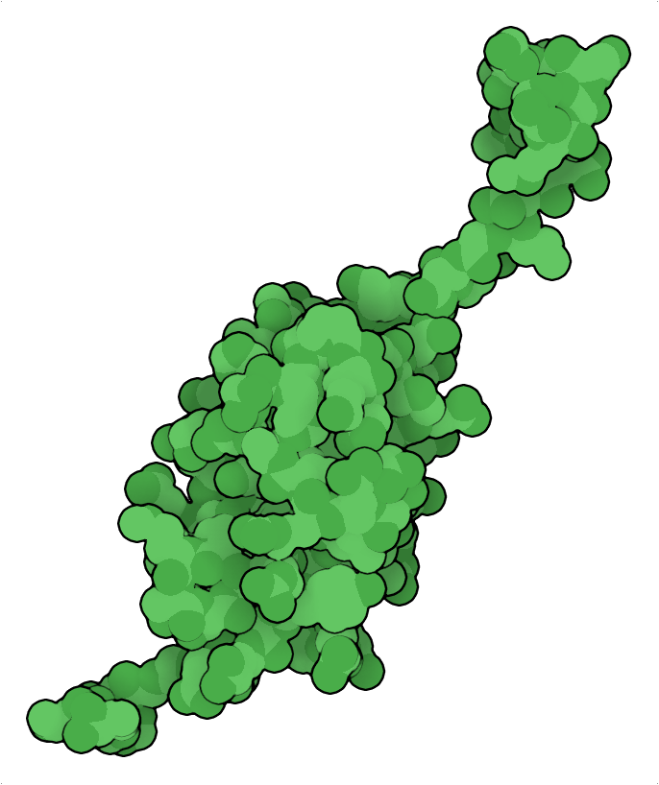
Post Translation Modification of IAV M1 Protein SUMOylation Modification Of M1
N-terminal Tail
Small Ubiquitin like Modifier (SUMO) has 4 paralogs, SUMO 1, 2, 3, and 4
SUMO 1/2/3 are the two most abundant of the SUMOs
SUMO 2/3 and are self SUMOylating and create SUMO chains
SUMO4 is very low abundance in the body, can be found in the kidney and lymph nodes
SUMO1
PDB:1A5R
C-terminal
(Di-glycine Motif)
Submitted "Identify human SUMOylation as an Essential Host Pathway for Influenza Virus Infections and Its Inhibition Leads minimal Mutation Escape“ Under Review Nature Communications
Notes:
Protein translocation, protein stability, cellular increase in DNA repair mechanisms, and cell division

Slide 29

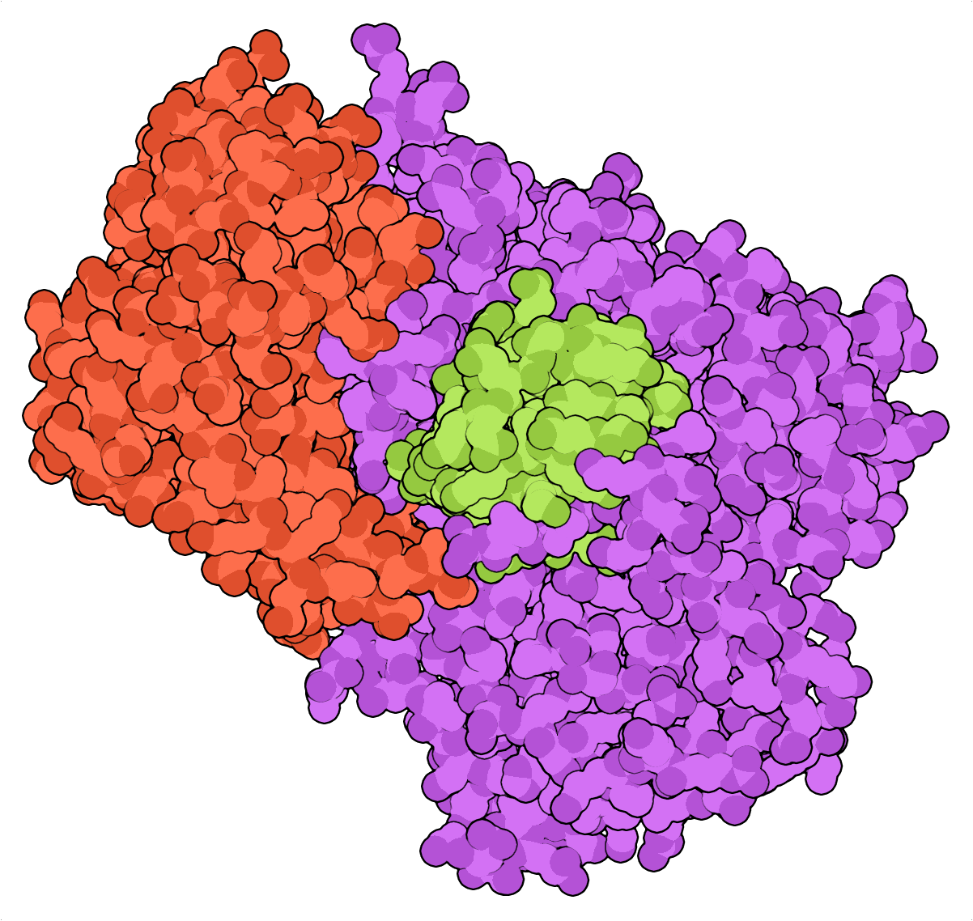
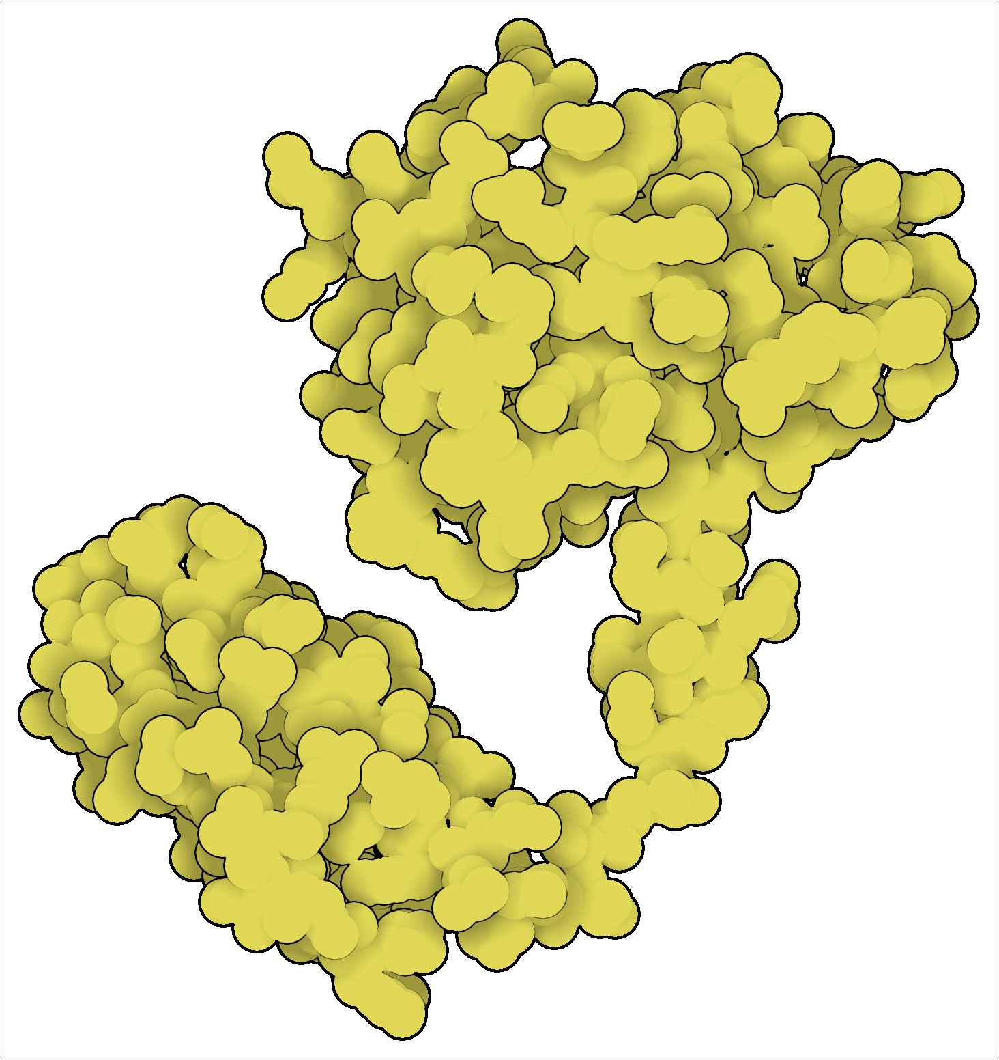
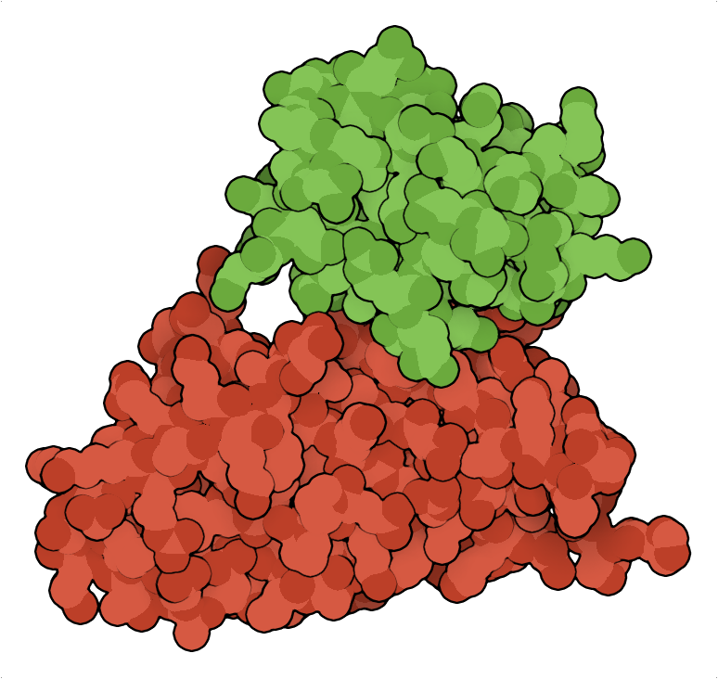
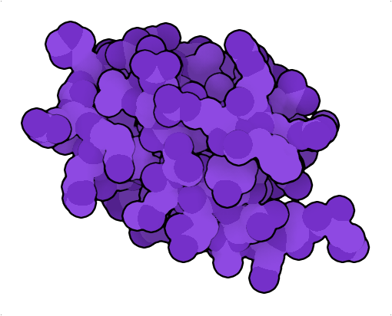
In-Vitro SUMOylation of Viral Proteins with qFRET Reporter
CyPet
FRET Pair CyPet and YPet
Activated-hSUMO1 (PDB:1A5R)
Enzyme Activating Complex 1 (EA1):(Uba2.AOS1.hSUMO) (PDB: 3KYC)
Conjugating Enzyme (E2): hUbc9.hSUMO1 (PDB:2PE6)
E3 Ligase: Protein Inhibitor Of Activated STAT1 (hPIAS1) (PDB:1V66 *)
Target Protein: Influenza A Virus Matrix 1 Protein (IAV-M1) (PDB:7jm3)
YPet
O
O
Gly98-hSUMO1
NH
Lys-IAV-M1
Gly98-hSUMO1
S
Cys173-UBA2
O
Gly98-hSUMO1
S
Cys93-UbC9
ATP
GG
Mg²⁺
PP_{i}
K
Submitted "Identify human SUMOylation as an Essential Host Pathway for Influenza Virus Infections and Its Inhibition Leads minimal Mutation Escape“ Under Review Nature Communications
UCR Disclosure ”FRET based SUMOE3 Ligase Assay” 06/2019
Notes:
SUMO1:1A5R
AOS1/UBA2/SUMO:3KYC
UBC9:color:2pe6:HexD46C40
UBC9/SUMO:2PE6
Pias1:https://swissmodel.expasy.org/
M1:
ATP+E1 adenylated and makes a thioester intermediate E1+SUMO1
Transferred to a catalytic cysteine93 residue on E2
Finally with the help of the E3 ligase with either a RING or HECT domain the SUMO is transferred to the target protein lysine residue

Slide 30
Results In vitro SUMOylation of YPet-IAV-M1 with qFRET Reporter
A
B
C
In-vitro SUMOylation Of IAV YPet-M1
with and without E3 Ligase PIAS1
***
***
**
ATP
- | + | +
+ | - | +
E3: PIAS1
T-test n = 3, p<0.0001*** p<0.001**
Submitted "Identify human SUMOylation as an Essential Host Pathway for Influenza Virus Infections and Its Inhibition Leads minimal Mutation Escape“ Under Review Nature Communications
UCR Disclosure ”FRET based SUMOE3 Ligase Assay” 06/2019

Slide 31
Results Mass Spectrometry Identified SUMO1 modified lysine
Lysine Position | SUMO Peptide Discovered | Enzyme
21 | GGTQEQYV | GluC
187 | GGTQEQYVEIVDEEEMG | Chymotrypsin
230 | GGTQEQYV | GluC
242 | GGTQEQYV | GluC
252 | GGTQ | GluC
K242
K230
K252
K21
K187
K47
K35
K57
K95, 98, 102, 104,113
Puerto Rico/1934
Submitted "Identify human SUMOylation as an Essential Host Pathway for Influenza Virus Infections and Its Inhibition Leads minimal Mutation Escape“ Under Review Nature Communications
Patent Filed “SUMOylation Inhibitors and Methods” 09/10/2021

Slide 32
Results In vitro SUMOylation of Mutant YPet-IAV-M1 with qFRET Reporter
C-terminal mutant and hexa mutant showed the most significant decrease in qFRET signal
+ATP/-ATP T-Test unpaired *** p<0.0001
***
***
***
**
**
**
***
***
**
*
**
***
**
***
ns
**
***
ns
ns
ns
ns
*
*
ns
***
ns
ns
ns
***
ns
ATP
PIAS1-E3
- | + | +
+ | - | +
- | + | +
+ | - | +
- | + | +
+ | - | +
- | + | +
+ | - | +
- | + | +
+ | - | +
- | + | +
+ | - | +
- | + | +
+ | - | +
- | + | +
+ | - | +
- | + | +
+ | - | +
- | + | +
+ | - | +
Wild Type | K21R | K35R | K187R | K230R | K242R | K252R | 21/35 NT** | 187/230/242/252 CT** | 21/35/187/230/242/252
Submitted "Identify human SUMOylation as an Essential Host Pathway for Influenza Virus Infections and Its Inhibition Leads minimal Mutation Escape“ Under Review Nature Communications

Slide 33
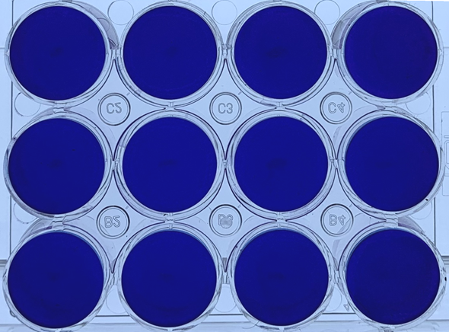
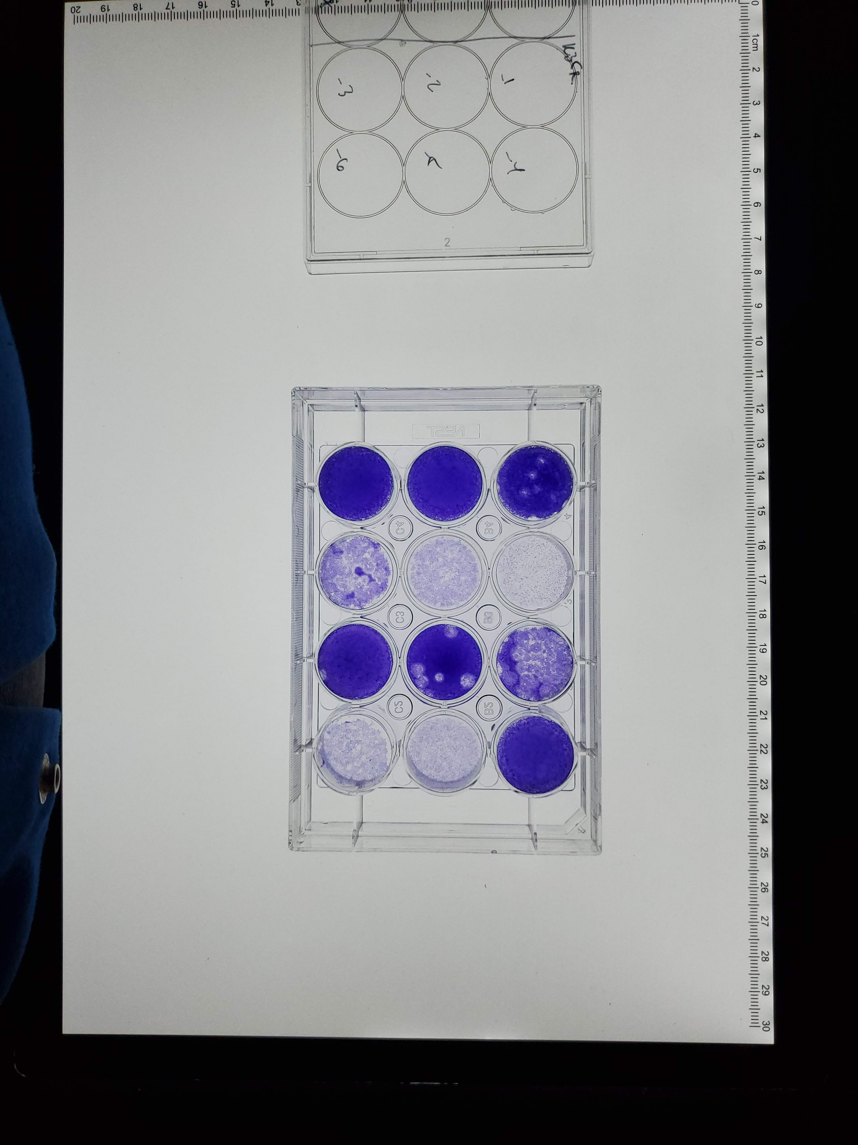
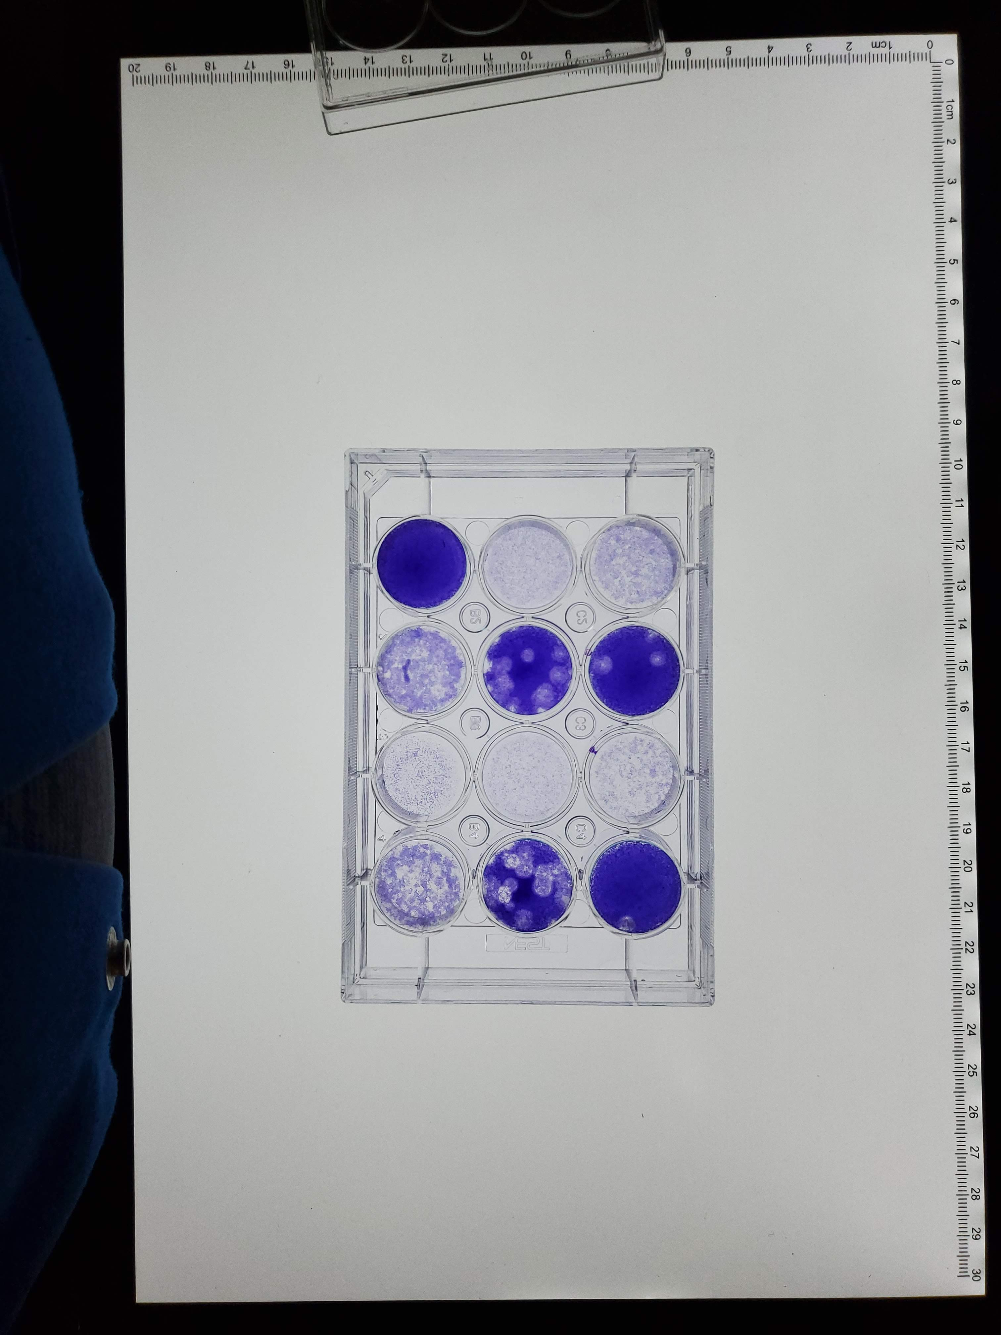
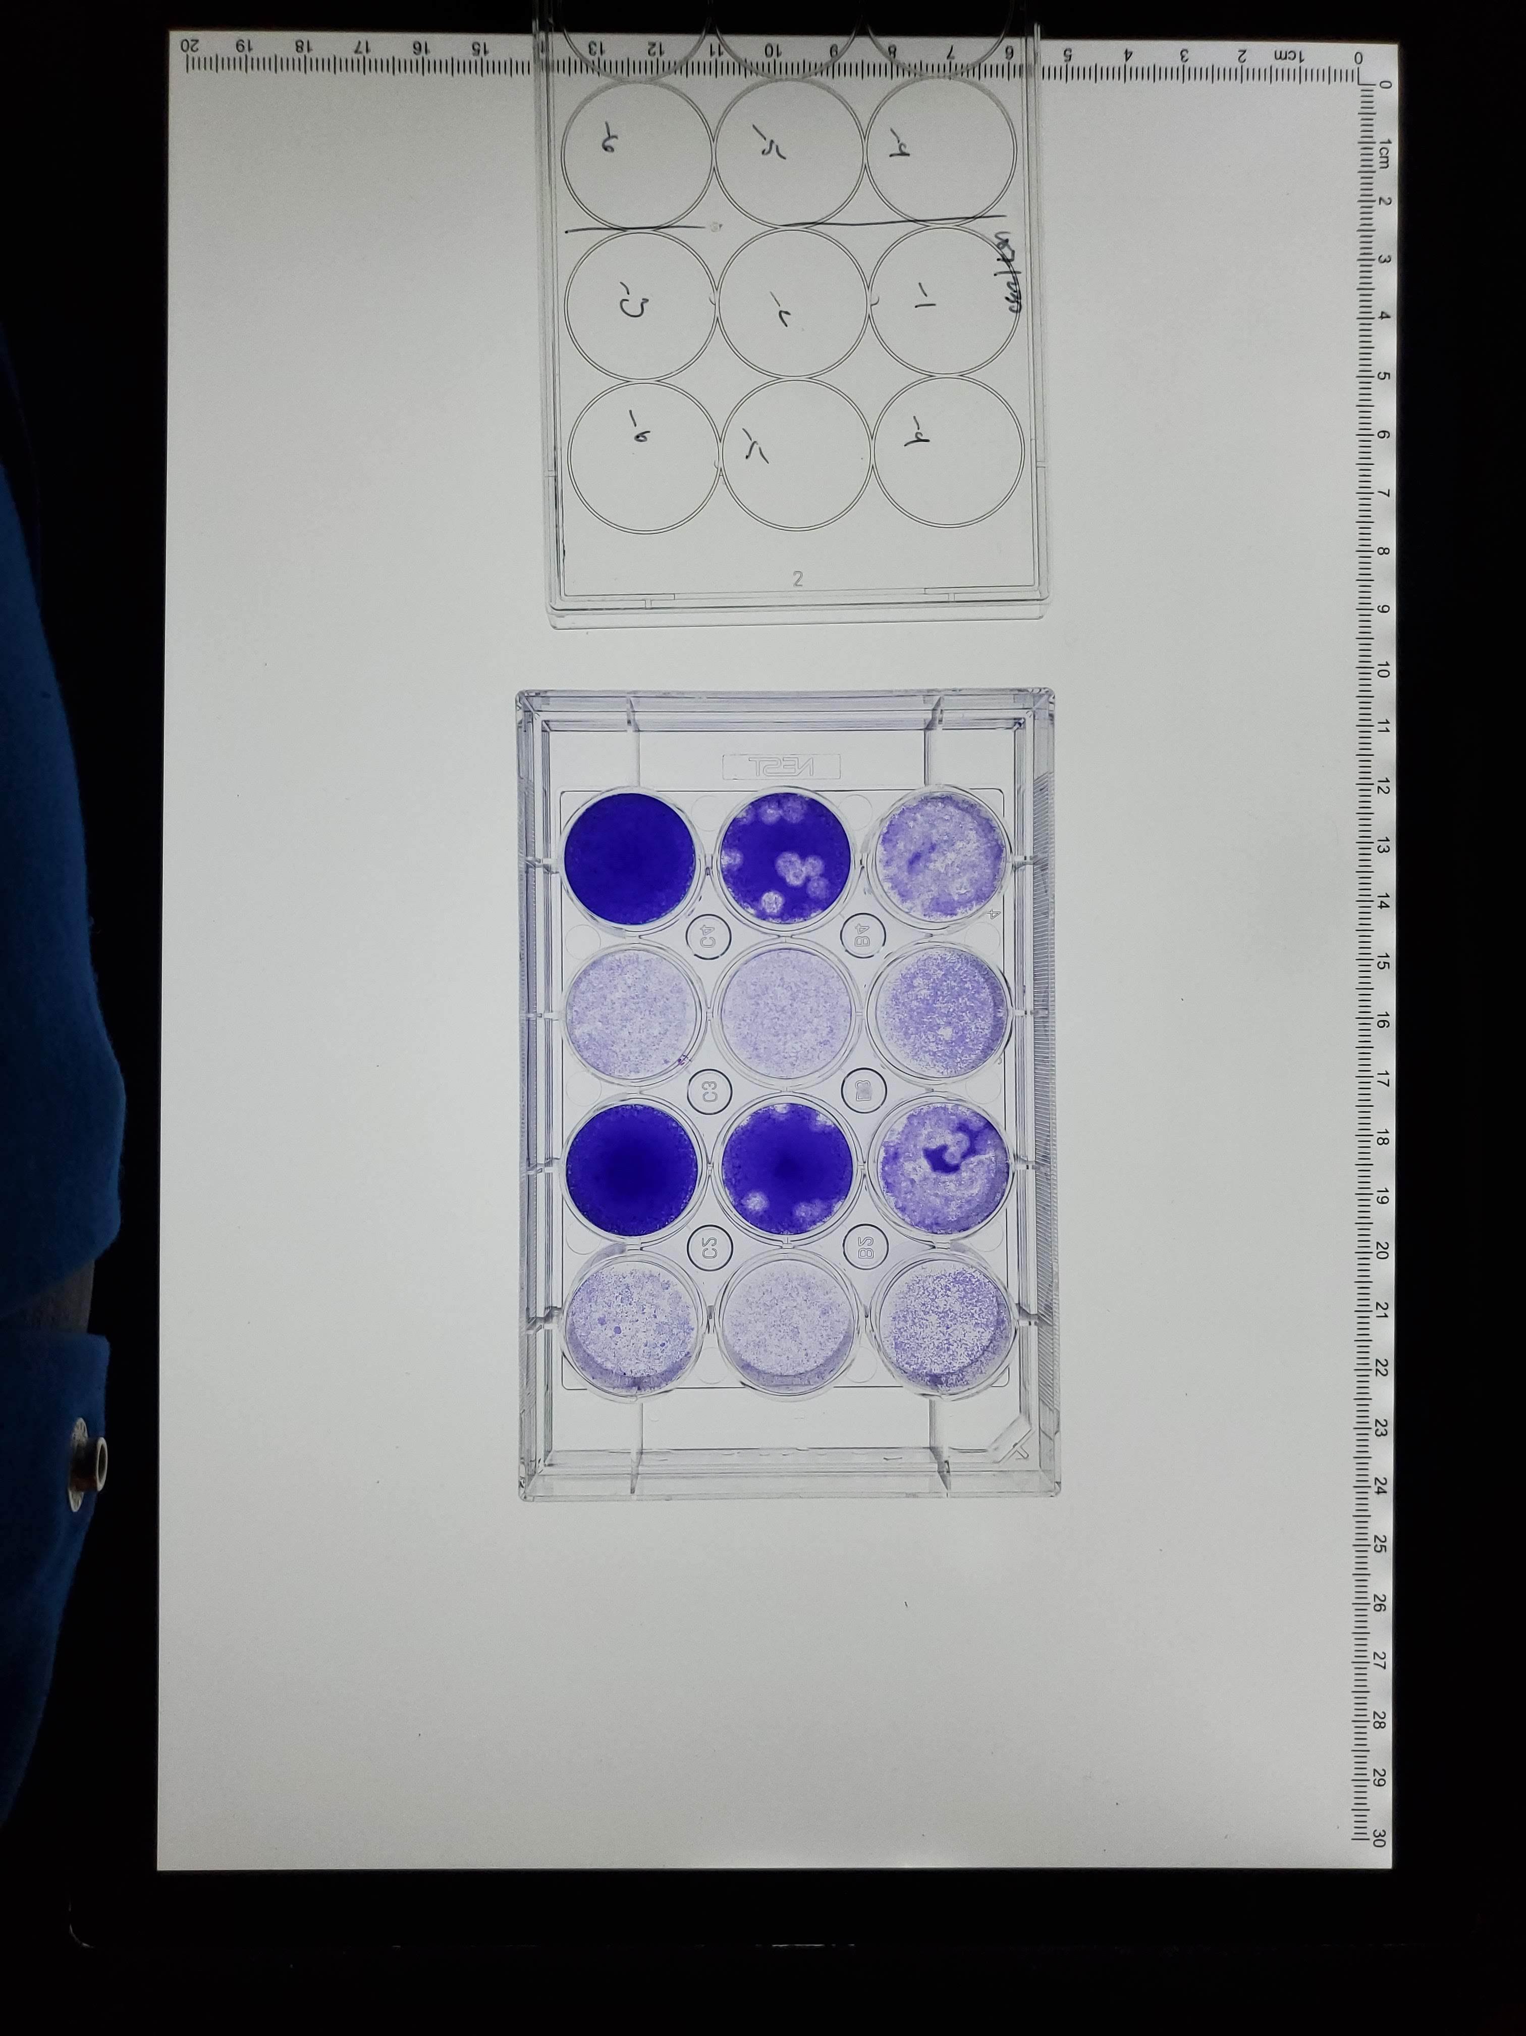
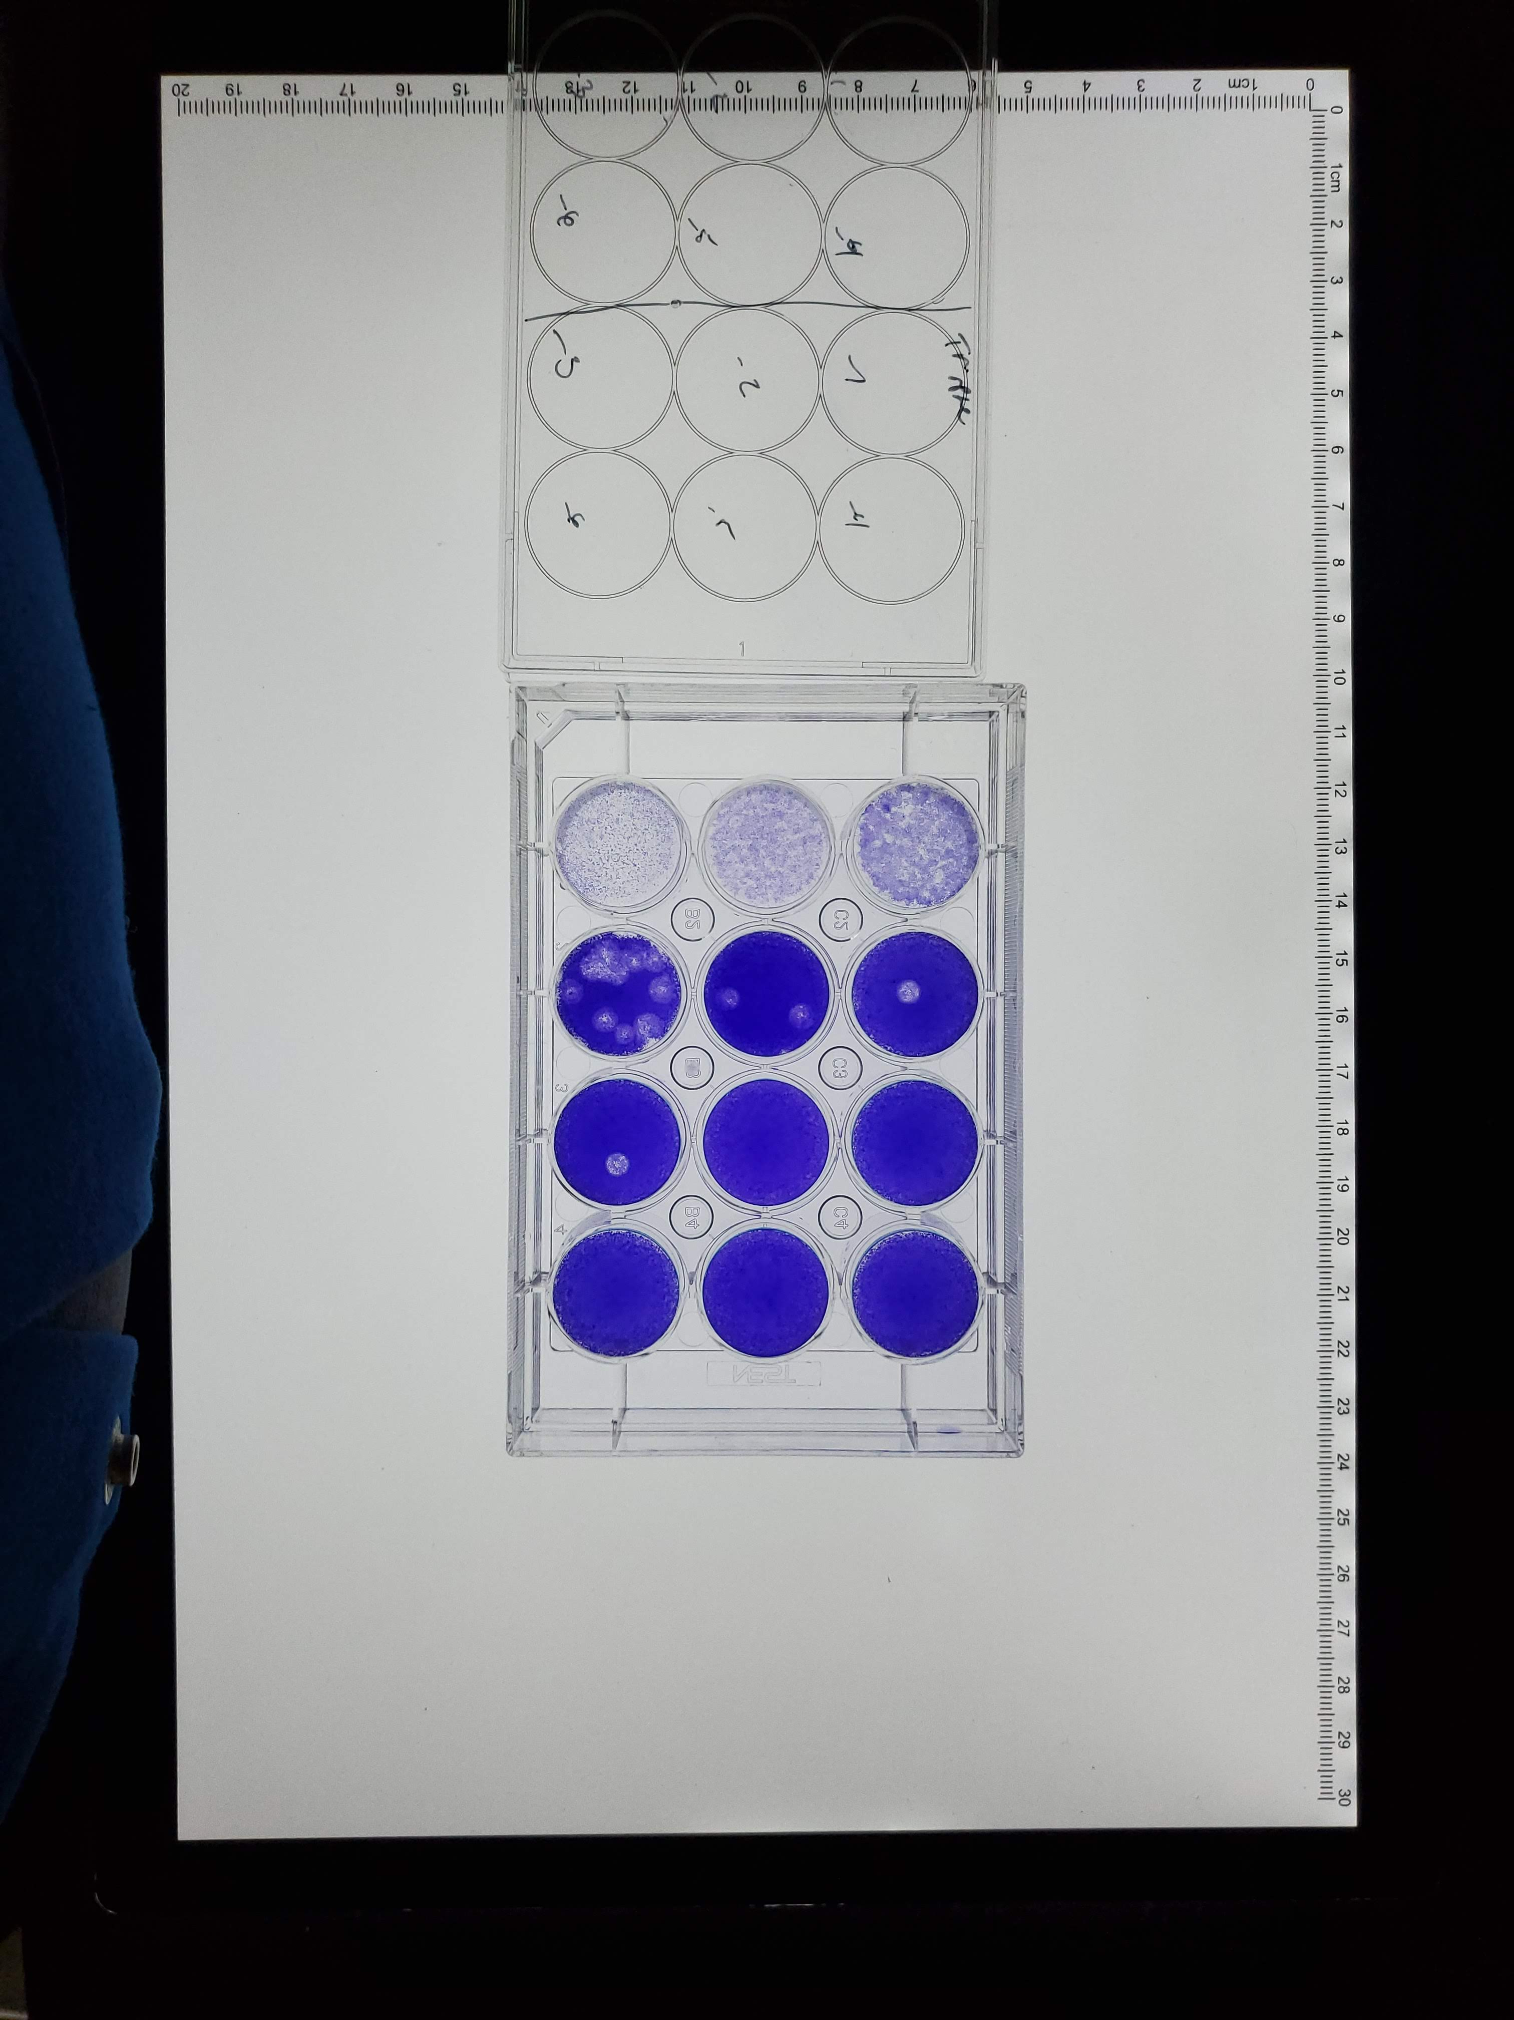
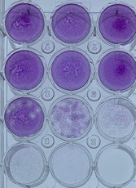
Results Viral plaque assay
 | IAV M1 Wild Type |  | IAV-M1 K21R |  | IAV-M1 K35R |  | IAV-M1 K187R
10⁻⁴
10⁻⁵
10⁻⁶
10⁻⁴
10⁻⁵
10⁻⁶
10⁻⁴
10⁻⁵
10⁻⁶
PBS
10⁻³
10⁻⁴
10⁻⁵
10⁻⁶
10⁻⁷
10⁰
10⁻²
10⁻³
10⁰
10⁻²
10⁻³
10⁰
10⁻²
10⁻³
 | IAV M1 K230R |  | IAV-M1 K242R |  | IAV-M1 K252R |  | K21,35,187,230,242,252R
10⁻⁴
10⁻⁵
10⁻⁶
10⁻⁴
10⁻⁵
10⁻⁶
10⁻⁴
10⁻⁵
10⁻⁶
10⁰
10⁻²
10⁻³
10⁻⁴
10⁻⁵
10⁻⁶
10⁰
10⁻²
10⁻³
10⁰
10⁻²
10⁻³
10⁰
10⁻²
10⁻³

Slide 34
Results Viral plaque assay and Kinetic Assay
Viral Cytotoxic Assay for M1 mutants
Starting MOI of 0.005 for each virus
Note M1 K21R was added undiluted
Submitted "Identify human SUMOylation as an Essential Host Pathway for Influenza Virus Infections and Its Inhibition Leads minimal Mutation Escape“ Under Review Nature Communications
Patent Filed “SUMOylation Inhibitors and Methods” 09/10/2021

Slide 35
Discussion and Conclusion IAV-Matrix 1 Protein
We observed M1 mutant K21R to have no viral pathogenesis
Confirmed lysine 21 mutant expression in two ways
Immunoprecipitation and Immunostaining
Modification | Position
Ubiquitination | K102/K104
Phosphorylation | Y132
NEDDylation | K187
SUMOylation | K21/K187/K230/K242/K252
Submitted "Identify human SUMOylation as an Essential Host Pathway for Influenza Virus Infections and Its Inhibition Leads minimal Mutation Escape“ Under Review Nature Communications
Patent Filed “SUMOylation Inhibitors and Methods” 09/10/2021

Slide 36
In vitro qFRET Assay for the SUMOylation of SARS-CoV-2 Nucleocapsid (N) protein

Slide 37
Results In vitro SUMOylation of SARS-CoV2-N Protein with qFRET Reporter
In vitro SUMOylation of N protein with increased concentration of donor and acceptor. SD shown in bars (One-way ANOVA with Tukey Test, p<0.0001***) (n=3)
Pre-Mass Spectrometry
qFRET report of N Protein SUMOylation
***
***
ns
ATP
- | + | +
+ | - | +
E3: PIAS1

Slide 38
Results Mass Spectrometry Identified SUMO1 modified lysine
Mass Spectrometry identified lysine sites with the SUMO modification.
Lysine 61 & 65
Lysine 61 and 65 are within the region of the site identified for SARS-CoV-1 Nucleocapsid protein
Lysine 347 and 355 are potential novel sites identified in the dimerization domain
K65
K355*
K61
K347*
SARS-Co V2 Nucleocapsid Protein
RNA Binding Domain
AA 50-174
Dimerization Domain
AA 246-365
Linker Region
Manuscript: SUMOylation of SARS-CoV2 Nucleocapsid protein

Slide 39
Results qFRET assay for in vitro SUMOylation of N Protein Mutants
N protein mutants SUMOylation reaction with (One-way ANOVA with Tukey’s Multiple Comparison Test p<0.0001*** p<0.05*)
***
***
***
***
***
***
***
***
***
***
***
***
***
***
NS
*
NS
***
Wild Type | K61R | K65R | K347R | K355R | K61,65R

Slide 40
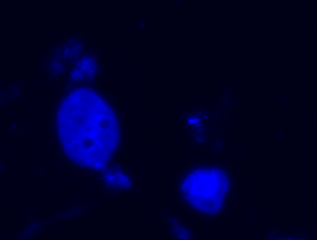
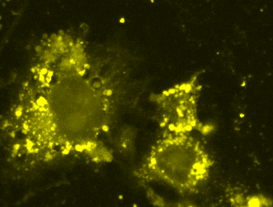
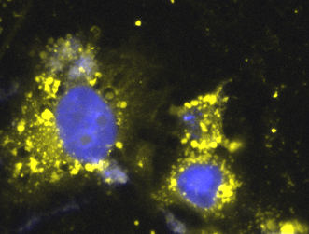
Results Cellular Translocation of Nucleocapsid Protein
Subcellular translocation studies a YPet-N Protein is expressed in HUH7 cells
YPet
Nucleocapsid Protein
Channel: Hoechst (375 nm) | Channel: YPet (530 nm) | Merged

Slide 41
Results Cellular Translocation of Nucleocapsid Protein
Wild Type | K61R | K65R | K347R | K355R
Hoechst
YPet
Merged

Slide 42
In vitro SUMOylation of N Protein Mutants
Cellular Function
Translocation
*Phosphorylation
Disease Progression
Protein-Protein Interaction
K_{D}
Protein Isoforms

Slide 43
SUMO1 modified N protein – affinity investigation by qFRET K_{D}
Oligomerization of N protein is evaluated by qFRET K_{D} of modified and unmodified N protein
Fusion proteins Cypet-N Protein and YPet-N Protein are setup for K_{D} with and without SUMOylation modification
Method takes advantage of qFRET technique of mixed protein kinetics
K_{D} Reaction 1 – Native Unmodified |  | K_{D} Reaction 2 – SUMO Modified
CyPet-N Protein | YPet-N Protein | SUMOylated CyPet-N Protein | SUMOylated YPet-N Protein
qFRET K_{D} of unmodified target proteins |  | qFRET K_{D} of modified target proteins
Native qFRET Kd
SUMOylated qFRET K_{D}
K_{D} N-Protein unmodified
K_{D} N-Protein Modified

Slide 44
Results SUMO1 modified N protein – affinity investigation by qFRET K_{D}
qFRET K_{D} N Protein Wildtype (Wt)
Modified K_{D}: 0.34 +/- 0.07 µM
Unmodified K_{D}: 0.82 +/- 0.18 µM
 | Un-Modified Wt N Protein | Modified Wt N Protein
K_{D} µM | 0.82 | 0.34
Standard Error µM | 0.18 | 0.07
95 % Confidence Interval µM | 0.44 to 1.20 | 0.18 to 0.50
R² | 0.97 | 0.97
n | 27 | 27

Slide 45
Discussion and Conclusion qFRET assay for in vitro SUMOylation of N Protein Mutants
In vitro SUMOylation assay with qFRET as a reporter coupled with MS provides alternative reliable method of evaluating modification of proteins
Demonstrated novel SUMO1 modification on K61/65/347/35 SARS-CoV-2 N protein
Reconstitution of SARS-CoV-2 is not currently possible, in vitro methods demonstrated here provide an alternative approach

Slide 46
Presentation Outline
Introduction to qFRET Technology
In vitro qFRET Based Assay for Interaction of PD1-PDL1
qFRET Based K_{D} and K_{i}
In vitro SUMOylation of IAV-M1 and SARS-CoV-2 Nucleocapsid protein with qFRET as a Reporter
Industry Experience

Slide 47
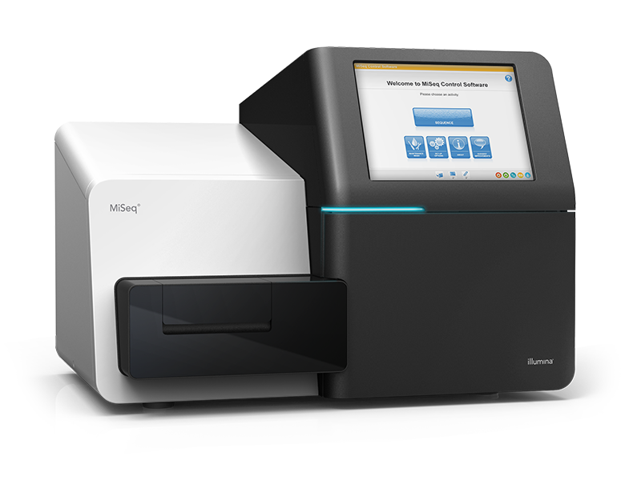
Industry Experience Systems Integration, Senior Research Associate
MiSeq – Integration Team
Prototype to customer release
Fluidic Module Development
Amplicon Workflow Development
1 Channel SBS Sequencing Development

Slide 48
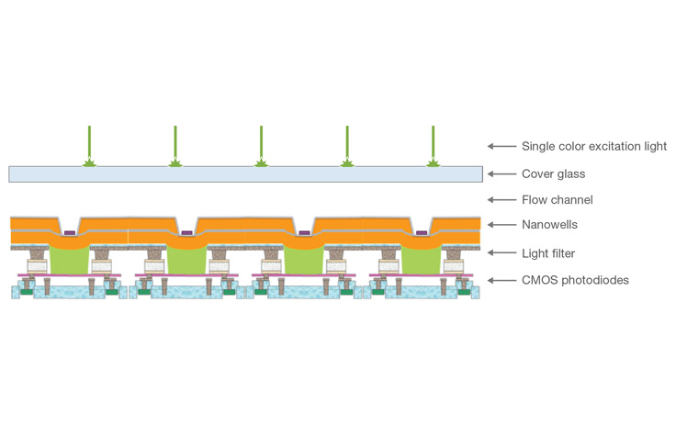
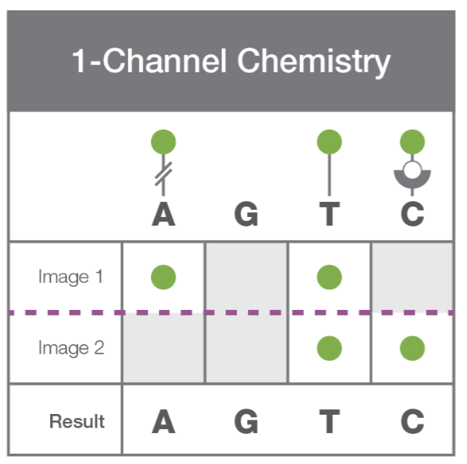
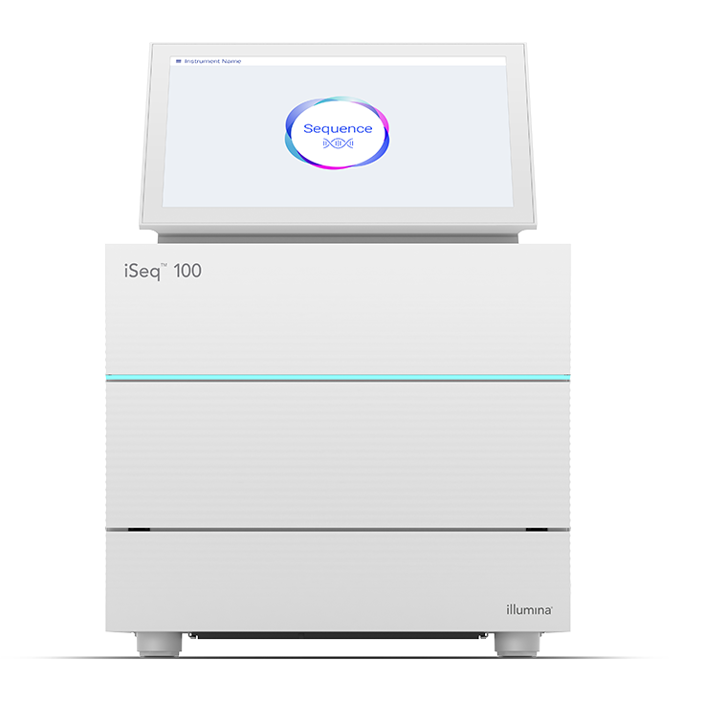
Industry Experience Systems Integration, Senior Research Associate
iSeq100 – Integration Team
Prototype development
One Channel SBS Sequencing development
Received team innovation award 2014 Q4

Slide 49
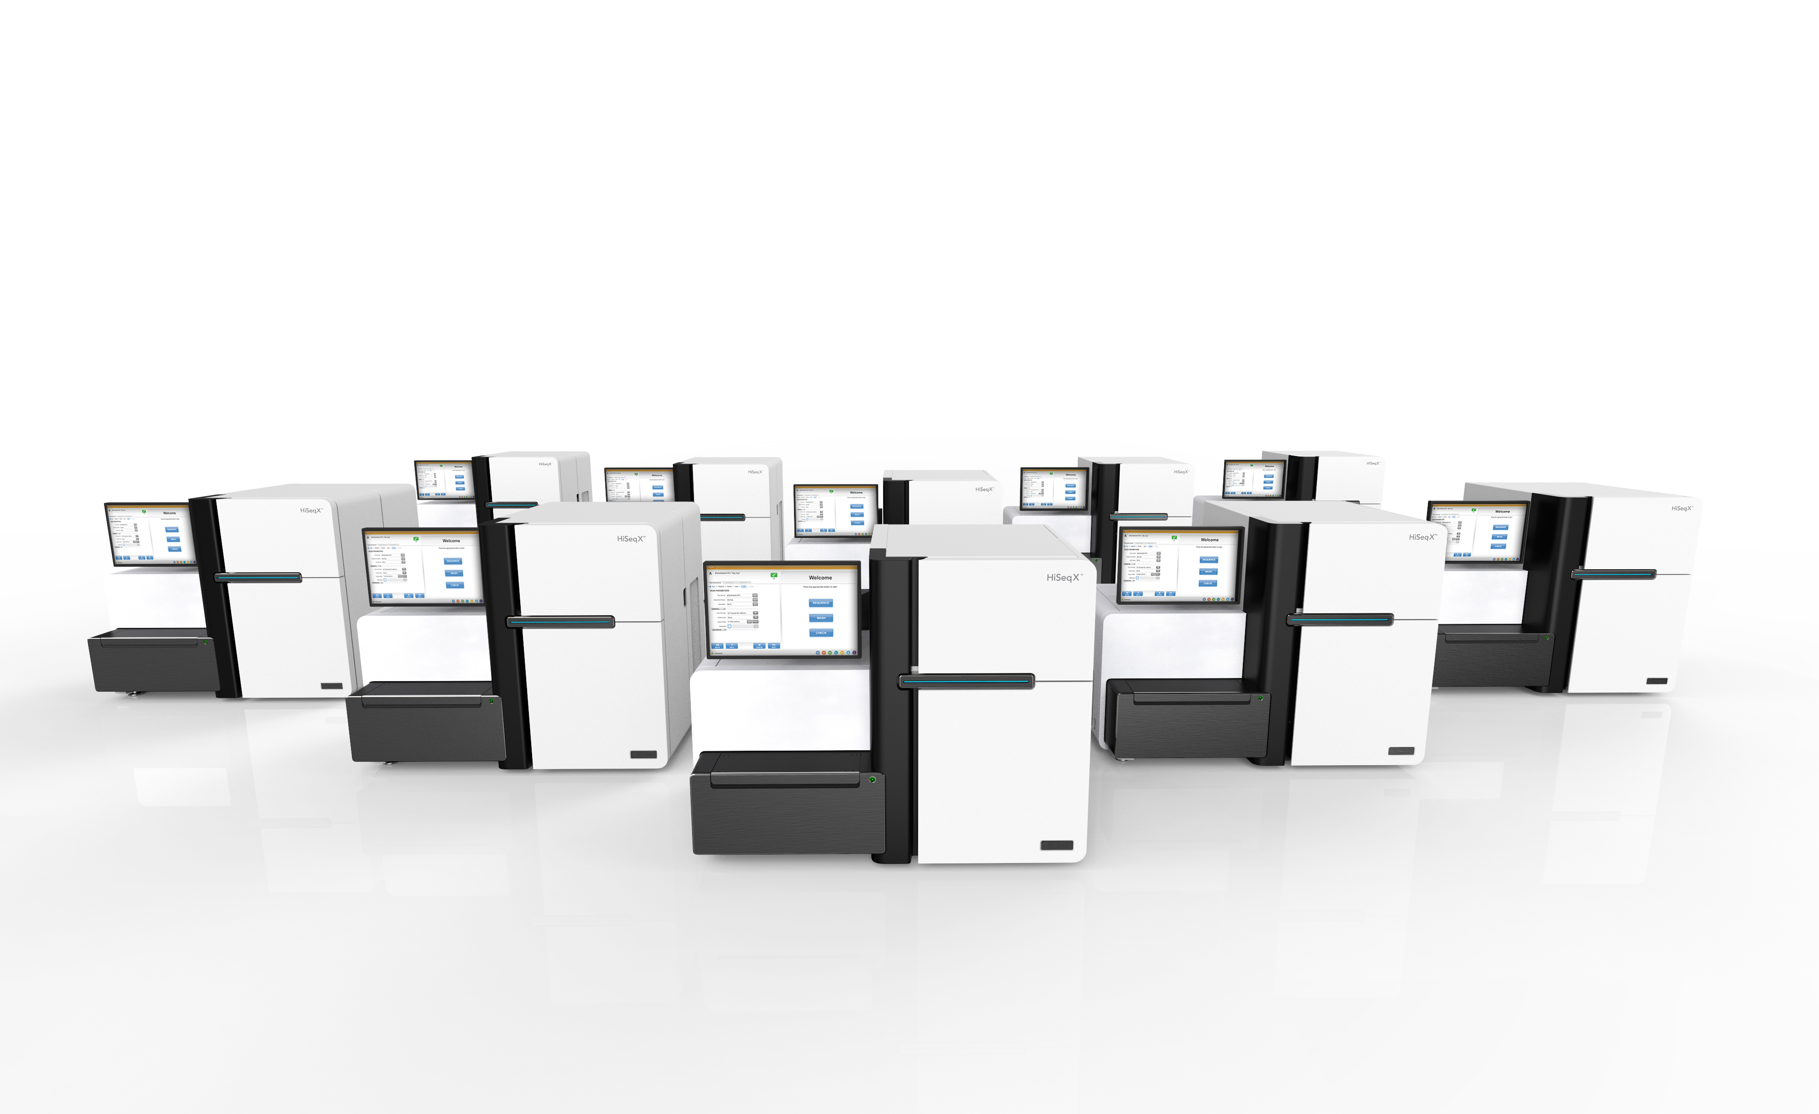
Industry Experience Systems Integration, Senior Research Associate
HiSeqX – Integration Team
Prototype to customer release
Patterned flow-cell development
Part of focus tracking team and FPGA team
Delivered first shipment to Macrogen in South Korea.

Slide 50
Thank you & Questions?

Slide 52
Appendix

Slide 53
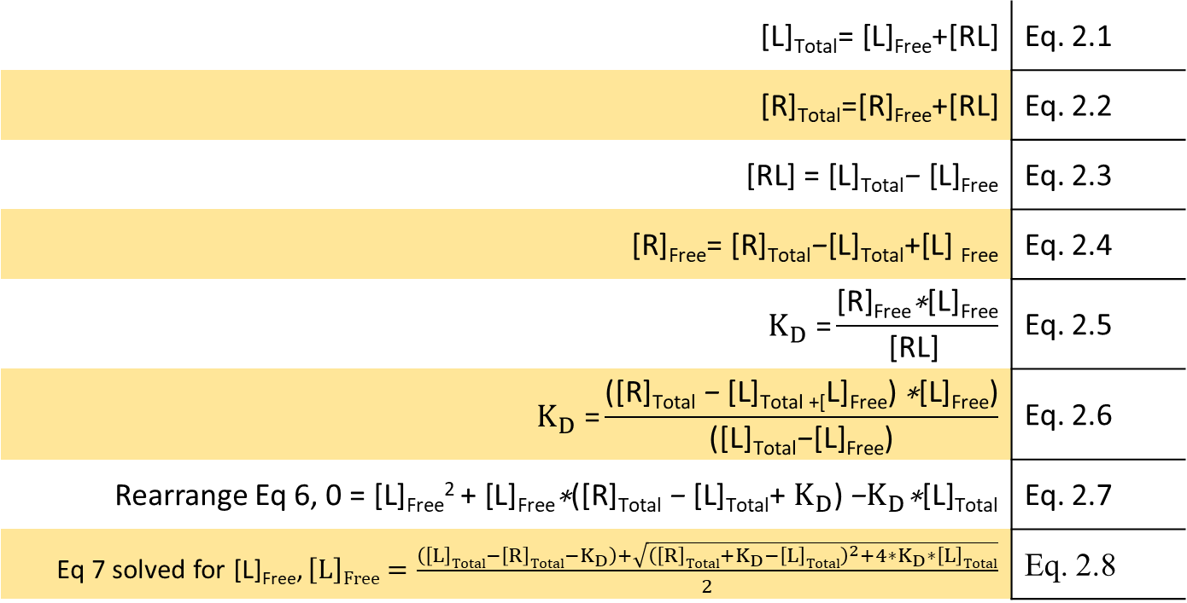
qFRET dissociation constant (K_{D}) Resolving qFRET based disassociation constant K_{D}
Given the following interaction scheme
K_{D}
$$\text{[}\text{L}\text{]}\text{Total}\text{=} \text{[}\text{L}\text{]}\text{Free}\text{+[}\text{RL}\text{]}$$ | Eq. 2.1
$$\text{[}\text{R}\text{]}\text{Total}\text{=[}\text{R}\text{]}\text{Free}\text{+[}\text{RL}\text{]}$$ | Eq. 2.2
$$\text{[}\text{RL}\text{]} \text{=} \text{[}\text{L}\text{]}\text{Total}\text{− }\text{[}\text{L}\text{]}\text{Free}$$ | Eq. 2.3
$$\text{[}\text{R}\text{]}\text{Free}\text{=} \text{[}\text{R}\text{]}\text{Total}\text{−}\text{[}\text{L}\text{]}\text{Total}\text{+[}\text{L}\text{] }\text{Free}$$ | Eq. 2.4
$$K_{D} \text{=}\frac{\text{[}\text{R}\text{]}\text{Free}\text{∗}\text{[}\text{L}\text{]}\text{Free}}{\text{[}\text{RL}\text{]} }$$ | Eq. 2.5
$$K_{D} \text{=}\frac{\text{([}\text{R}\text{]}\text{Total}\text{ − }\text{[}\text{L}\text{]}\text{Total}\text{ +[}\text{L}\text{]}\text{Free}\text{)} \text{∗}\text{[}\text{L}\text{]}\text{Free}\text{)}}{\text{([}\text{L}\text{]}\text{Total}\text{−}\text{[}\text{L}\text{]}\text{Free}\text{)}}$$ | Eq. 2.6
Rearrange Eq 6, $\text{0} \text{=} \text{[}\text{L}\text{]}\text{Free}\text{2} \text{+} \text{[}\text{L}\text{]}\text{Free}\text{∗}\text{([}\text{R}\text{]}\text{Total}\text{ − }\text{[}\text{L}\text{]}\text{Total}\text{+} K_{D}\text{)}\text{ −}K_{D}\text{∗}\text{[}\text{L}\text{]}\text{Total}$ | Eq. 2.7
Eq 7 solved for [L]_{Free}, $\left[L\right]Free=\frac{\left(\left[L\right]Total−\left[R\right]Total−K_{D}\right)+\sqrt{{\left(\left[R\right]Total+K_{D}−\left[L\right]Total\right)}^{2}+4∗K_{D}∗\left[L\right]Total}}{2}$ | Eq. 2.8
[R]+[L]
[RL]
Manuscript: Development of qFRET assay for PD1-PDL1 interaction

Slide 54
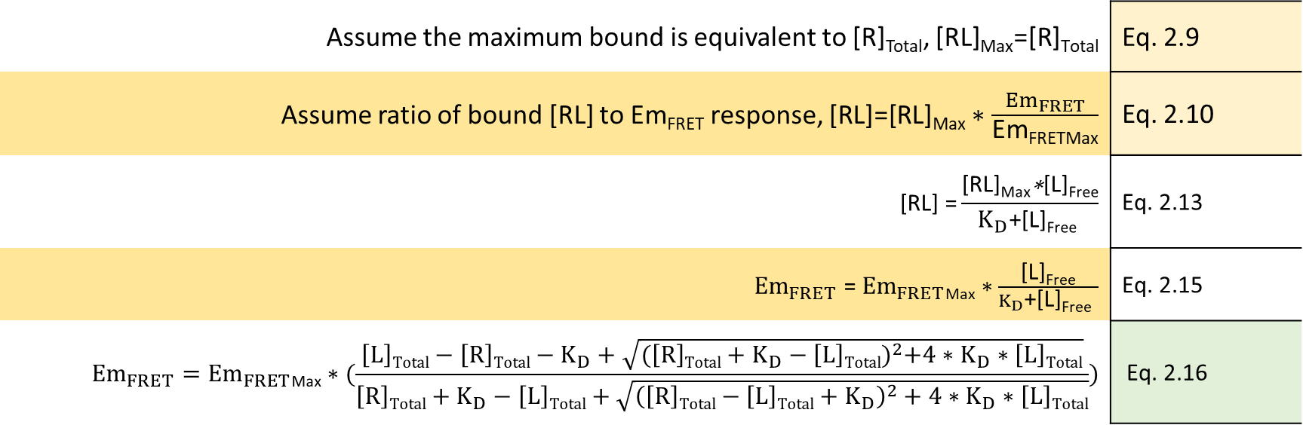
qFRET dissociation constant (K_{D}) Resolving qFRET based disassociation constant K_{D}
Given the following interaction scheme
K_{D}
[R]+[L]
[RL]
Assume the maximum bound is equivalent to [R]_{Total}, $\text{[}\text{RL}\text{]}\text{Max}\text{=[}\text{R}\text{]}\text{Total}$ | Eq. 2.9
Assume ratio of bound [RL] to Em_{FRET} response, $\text{[}\text{RL}\text{]=[}\text{RL}\text{]}\text{Max}∗\frac{{Em}_{FRET}}{\text{Em}\text{FRETMax}}$ | Eq. 2.10
$$\text{[}\text{RL}\text{]} \text{=}\frac{\text{[}\text{RL}\text{]}\text{Max}\text{∗}\text{[}\text{L}\text{]}\text{Free}}{K_{D}\text{+[}\text{L}\text{]}\text{Free} }$$ | Eq. 2.13
${Em}_{FRET}$ = ${Em}_{FRET}\text{Max}∗\frac{\text{[}\text{L}\text{]}\text{Free}}{K_{D}\text{+[}\text{L}\text{]}\text{Free} }$ | Eq. 2.15
$${Em}_{FRET}={Em}_{FRET}\text{M}\text{a}\text{x}∗(\frac{\left[L\right]Total−\left[R\right]Total−K_{D}+\sqrt{{(\left[R\right]Total+K_{D}−\left[L\right]Total)}^{2}+4∗K_{D}∗\left[L\right]Total}}{\left[R\right]Total+K_{D}−\left[L\right]Total+\sqrt{{\left(\left[R\right]Total−\left[L\right]Total+K_{D}\right)}^{2}+4∗K_{D}∗\left[L\right]Total}})$$ | Eq. 2.16
Manuscript: Development of qFRET assay for PD1-PDL1 interaction

Slide 55
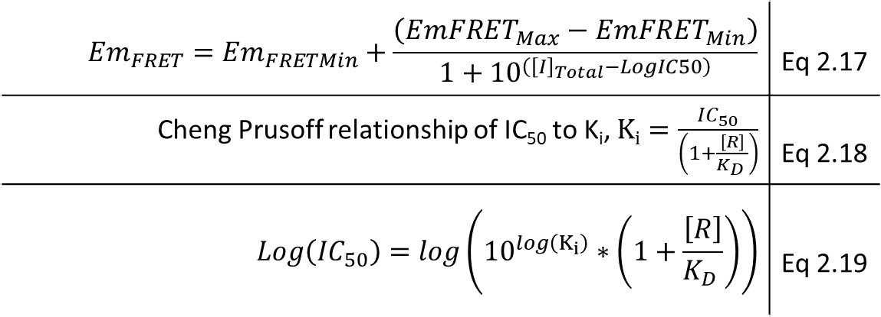
qFRET rate of inhibition K_{i} Resolving qFRET based rate of inhibition K_{i}
To evaluate inhibitor activity using qFRET we utilize Cheng Prusoff relationship of rate of inhibition K_{i} to IC₅₀
$${Em}_{FRET}={Em}_{FRETMin}+\frac{\left({EmFRET}_{Max}−{EmFRET}_{Min}\right)}{1+{10}^{\left({\left[I\right]}_{Total}−LogIC50\right)}}$$ | Eq 2.17
Cheng Prusoff relationship of IC₅₀ to K_{i}, $Ki=\frac{{IC}_{50}}{\left(1+\frac{\left[R\right]}{K_{D} }\right)}$ | Eq 2.18
$$Log\left({IC}_{50}\right)=\log\left({10}^{\log\left(K_{i}\right)}∗\left(1+\frac{\left[R\right]}{K_{D} }\right)\right)$$ | Eq 2.19
PD1
PDL1
Manuscript: Development of qFRET assay for PD1-PDL1 interaction

Slide 56
2.5 Results Expression and codon optimization of full length PD1 and PDL1
Codon Adaptation Index – (CAI) is a measure of a genes use of codons in reference to a codon RSCU
CAI value is calculated for a gene, given a relative adaptiveness for codon usage
Geometric mean of relative adaptiveness (w) of a codon from the start codon to the stop codon
Using R-BioConductor Package – developed codon optimization script to optimize for E coli BL21(DE3)
 | CAI Score Human | CAI Score E. coli Wildtype | CAI Score E. coli Optimized
hPDL1 | 0.7 | 0.6 | 0.9
hPD1 | 0.8 | 0.6 | 0.9
$${CAI=(\prod_{k=1}^{L}{w_{k}})}^{\frac{1}{L}}$$
Paul M.Sharp1-2* and Wen-Hsiung Li2, “The codon adaptation index - a measure of directional synonymous codon usage bias, and its potential applications”, Nucleic Acid Research, 15, 1987

Slide 57
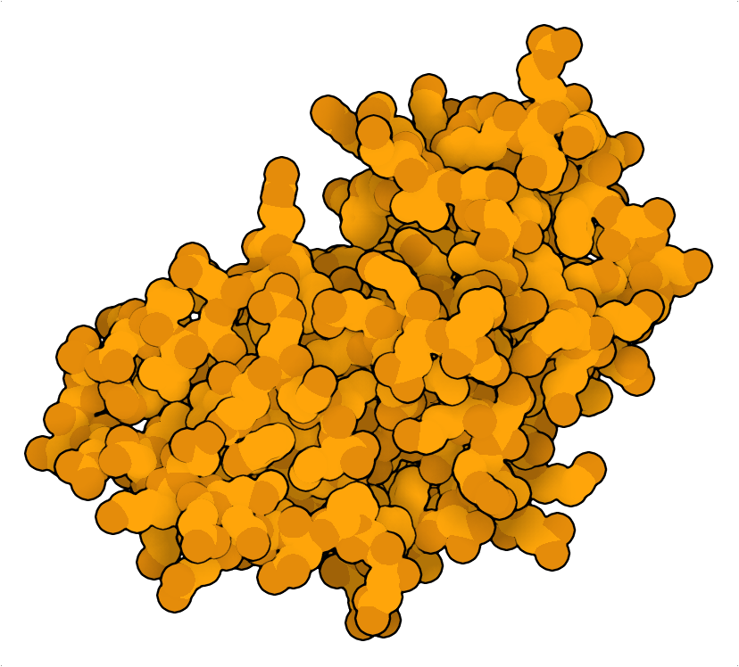
Introduction to qFRET Technology Background and Significance
Sentrin/SUMO-specific protease SENP1 (2CKG)
Activated-hSUMO1 (PDB:1A5R)
Enzyme Activating Complex 1 (EA1):(Uba2.AOS1.hSUMO) (PDB: 3KYC)
Conjugating Enzyme (E2): hUbc9.hSUMO1 (PDB:2PE6)
E3 Ligase: Protein Inhibitor Of Activated STAT1 (hPIAS1) (PDB:1V66 *)
Target Protein:
E
B
O
O
NH
Lys-Target
S
C
Gly98-hSUMO1
Gly98-hSUMO1
Cys173-UBA2
O
A
S
Cys93-UbC9
Gly98-hSUMO1
ATP
GG
Mg²⁺
PP_{i}
K
D
Goodsell, D. S., Autin, L. & Olson, A. J. Illustrate: Software for Biomolecular Illustration. Structure 27, 1716-1720.e1 (2019).
Notes:
SUMO1:1A5R
AOS1/UBA2/SUMO:3KYC
UBC9:color:2pe6:HexD46C40
UBC9/SUMO:2PE6
Pias1:https://swissmodel.expasy.org/
M1:
ATP+E1 adenylated and makes a thioester intermediate E1+SUMO1
Transferred to a catalytic cysteine93 residue on E2
Finally with the help of the E3 ligase with either a RING domain the SUMO is transferred to the target protein lysine residue

Slide 58
2.5 Results Refolding of the External Domain of hPD1 and hPDL1
Refolding inclusion body by stepwise dialysis
Denature Inclusion body in denaturant
Stepwise dilute denaturant allow amino acids to fold slowly
Dissolve inclusion body in denaturant
Step-wise remove denaturant
Refolded Protein
1.) Soluble Intermediate
2.) Misfolded aggregates
Denaturant: Guanidine
Aggregation Inhibitor: Arginine

Slide 59
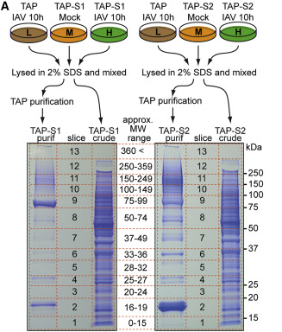
Post Translation Modification of IAV M1 Protein SUMOylation Modification Of M1
Domingues P. et al. group utilized a “slice by slice” technique to determined modified proteins
SILAC Technique with overexpression of SUMO protein followed by viral infection
SUMO proteins are TAP tagged (protein A and CBP tag) a sequential purification results in complex of modified proteins
Inferred modification with band shift
Domingues, P. et al. Global Reprogramming of Host SUMOylation during Influenza Virus Infection. Cell Rep 13, 1467–1480 (2015).

Slide 60
Summary of Current PTMs
Current status of PTM identification for M1 is tabulated
Viral pathogenesis was terminated with Ubiquitin and Phosphorylation mutants
Phosphorylation modulated translocation of M1
NEDDylation mutants improved infectivity
The Wu et al study utilized a prediction method for investigating potential SUMOylation sites and tested only K242 and 187
Modification | Position | Study
Ubiquitination | K102/ K104 | Mahesutihan et al (2018)
Phosphorylation | Y132 | Wang et al (2012)
NEDDylation | K187 | Li et al (2020)
SUMOylation | K242 | Wu et al (2011)
K102
Y132
K104
K187
K242
105
101
NLS
1
87
165
252
Dimerization domain
N – terminal domain
C – terminal domain
Notes:
hydrophobic residue (Ψ), the modified lysine (K), any amino acid, and either an aspartic acid or a glutamic acid.

Slide 61
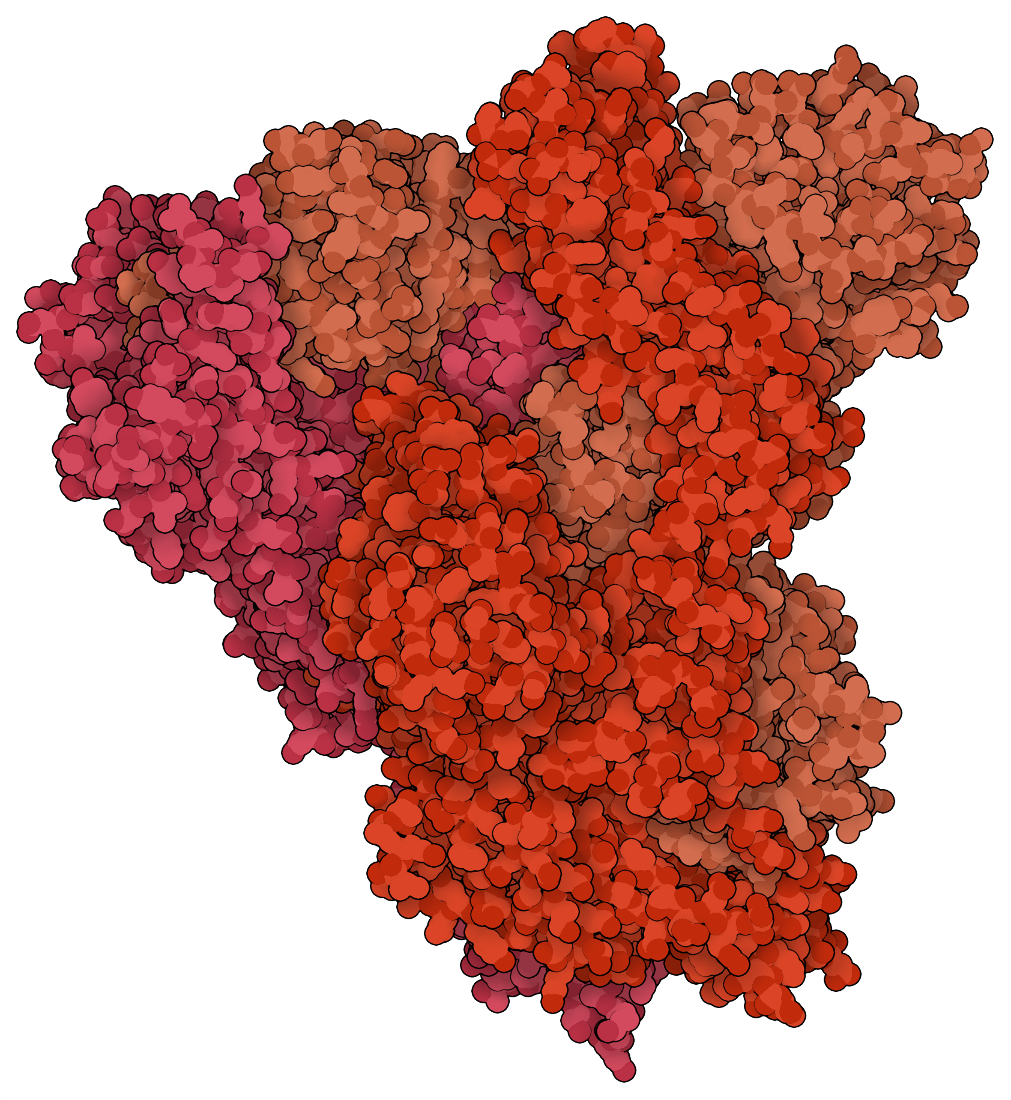
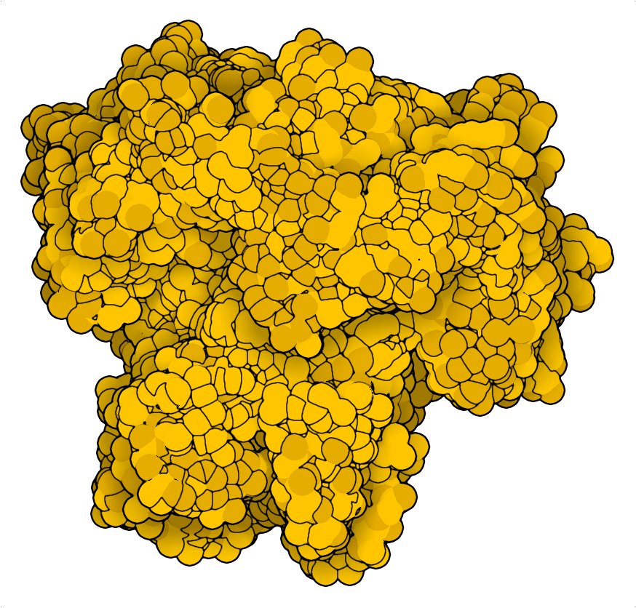
4.1 SARS-CoV-2 Life Cycle Severe acute respiratory syndrome coronavirus 2 (SARS-CoV-2)
Spike Protein (S)
PDB:5x5b
Severe acute respiratory syndrome coronavirus 2 (SARS-CoV-2), an enveloped positive-stranded RNA virus currently, July 2021 is still a global pandemic
Viral particle contains positive sense viral RNA ~30 kb
Compacted vRNA is packaged by Nucleocapsid protein
Lipid membrane holds membrane protein (M), envelope protein (E)m and Spike protein (S)
80 nm
Nucleocapsid Protein (N)
Envelope Protein (E)
PDB:5x29
vRNA ~30 kbp
Membrane Protein (M)

Slide 62
4.1 SARS-CoV-2 Life Cycle Severe acute respiratory syndrome coronavirus 2 (SARS-CoV-2)
NSPs
Ribosome
Lysosome – with formed viral particle
DMVs
TMPRESS2
vRNA
ER
Native RNA is cleaved and destroyed
ACE2
Golgi Apparatus
S Protein
1.) Viral entry begins when spike protein binds to ACE2 and TMPRSS2 cleaves spike protein which results in the fusion of viral particle to cell membrane
2.) Viral RNA is translated as an amino acid chain and NSP3 & 5 proteases process the aa chain into non-structural proteins (NSPs) the cytosol, (NSP1-16)
3.) NSPs block anti viral response elements from being expressed and degrade host RNA
4.) Double Membrane Vesicles (DMV) are formed from ER to hold and replicate vRNA, with the help of NSP proteins
5.) Lysosome is formed containing the formed viral particle to be eventually released out of the cell.

Slide 63
4.1 SARS-CoV-2 Life Cycle Severe acute respiratory syndrome coronavirus 2 (SARS-CoV-2)
STAT
IFN
STAT
Nucleocapsid Protein is found in the cytosol and has been reported to shuttle in and out of the nucleus.
Inhibition of interferon anti-viral response by sequestering STAT 1 and 2 in the cytosol
Phosphorylation at linker region

Slide 64
5.5 Z’ Qualification Assay Overview
12/24/64
The Z’ qualification is completed over 3 days
The purpose is to run a mock screening with preparation of buffers and proteins
Reactions in an inter-weave patters to test the instrument variation
8/16/24

Slide 65
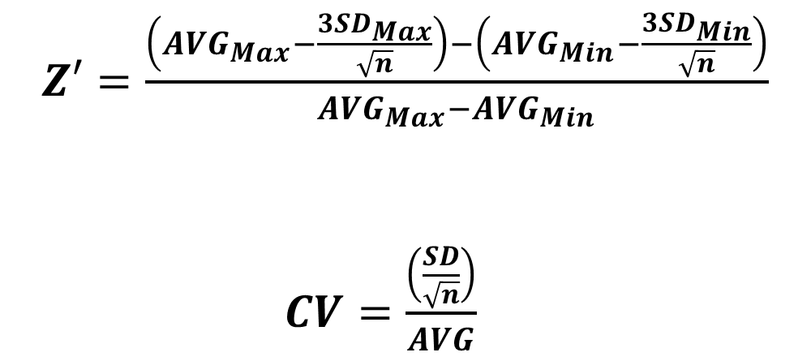
5.5 Z’ Qualification Assay Overview
The Z’ is evaluated for each day over 3 plates
The criteria used is Z’ must be > 0.4
Coefficient of variance must be below 20%
$Z′=\frac{\left({AVG}_{Max}−\frac{3{SD}_{Max}}{\sqrt{n}}\right)−\left({AVG}_{Min}−\frac{3{SD}_{Min}}{\sqrt{n}}\right)}{{AVG}_{Max}−{AVG}_{Min}}$
$CV=\frac{\left(\frac{SD}{\sqrt{n}}\right)}{AVG}$

Slide 66
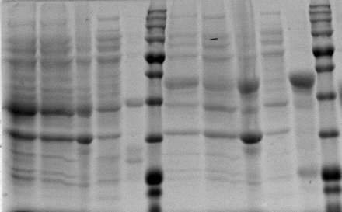
Challenges In Expression Of PD1 and PDL1
Rescued from IB
Rescued from IB
Un-Induced
Un-Induced
Soluble Fraction
Soluble Fraction
Insoluble Fraction
Insoluble Fraction
The resulting proteins are ran on SDS-PAGE gel and coomassie stained
The wildtype external domain of PDL1 gave low yields after purification
Induced
Induced
CyPet-extPDL1 (58kD)
YPet-extPD1 (48kD)
YPet-Ext.PD1
CyPet-Ext.PDL1
Refolded protein yield | (ug for a Liter of 2xYT) | uM
YPet-extPD1 | 282 | 8
CyPet-extPDL1 | 12 | 0.2
Manuscript: Development of qFRET assay for PD1-PDL1 interaction
Notes:
Figure ##: SDS-PAGE gel, coomassie stain for determination of protein expression and validation of protein purification. 1-BL21(DE3) YPet-Ext.PD1 Induced expression, 2-BL21(DE3)YPet-Ext.PD1 Un-induced, 3-Cell Pellet, 4-Cell Lysate,5-Purified and refolded from inclusion body YPet-PD1, 6-BL21(DE3) CyPet-Ext.PDL1 Induced expression, 7-BL21(DE3)CyPet-Ext.PDL1 Un-induced, 8-Cell Pellet, 9-Cell Lysate,10-Purified and refolded from inclusion body CyPet-PDL1. MW of YPet-Ext.PD1 is 48 kDA and CyPet-Ext.PDL1 is 58 kDa.

Slide 67
Codon Optimization
Version 1 | Version 2 | Version 3 | Version 4 - Pending
Codon selected for the highest abundance of tRNA | Codon selected for least number of mutations. (2nd or wobble base pair) Point mutation for each codon below a set threshold of codon relative adaptiveness | Selected for least number of mutations by a set threshold of w score Adjusted for Ribosome landing and stop codon insertion and Ribosome take-off | Selected for least number of mutations by a set threshold of w score Adjusted for RNA polymerase landing and stop codon incorporation Monitored mRNA secondary structure for hairpin formation

Slide 68
Challenges In Expression Of PD1 and PDL1
His-Tag Purified
His-Tag Purified
His-Tag Purified
His-Tag Purified
Un-Induced
Un-Induced
Un-Induced
Un-Induced
Soluble Fraction
Soluble Fraction
Soluble Fraction
Soluble Fraction
Insoluble Fraction
Insoluble Fraction
Insoluble Fraction
Insoluble Fraction
Induced
Induced
Induced
Induced
Wild Type | Codon Optimized
CyPet-PD1
Wild Type | Codon Optimized
YPet-PDL1
Manuscript: Development of qFRET assay for PD1-PDL1 interaction

Slide 69
Results: SUMOylation of N Protein Mass Spectrometry Identified SUMO1 modified lysine
NC Lysine 61
b⁺ | b⁺ | b⁺ | b⁺ | b⁺ | b⁺ | b⁺ | b⁺ | b⁺ | b²⁺ | b²⁺ | b²⁺ | b²⁺ | b³⁺ | b²⁺ | b²⁺ | b³⁺ | b²⁺ | b³⁺ | b²⁺ | b⁴⁺ | b³⁺ | b³⁺ | b⁴⁺ | b²⁺ | b²⁺
 | R | P | Q | G | L | P | N | N | T | A | S | W | F | T | A | L | T | Q | H | G | K-S | E | D | L | K | F | P
 |  |  | y³⁺ | y⁴⁺ | y³⁺ | y³⁺ | y³⁺ | y³⁺ | y³⁺ | y²⁺ | y³⁺ | y³⁺ | y⁴⁺ | y²⁺ | y²⁺ | y²⁺ | y²⁺ | y⁺ | y⁺ | y⁺ | y⁺ | y⁺ | y²⁺ | y²⁺ | y⁺ | y⁺ | y⁺ | y⁺
GGTQ

Slide 70
Results: SUMOylation of N Protein Mass Spectrometry Identified SUMO1 modified lysine
NC Lysine 65
b⁺ | b⁺ | b⁺ | b⁺ | b⁺ | b⁺ | b⁺ | b⁺ | b⁺ | b²⁺ | b²⁺ | b²⁺ | b²⁺ | b³⁺ | b²⁺ | b²⁺ | b³⁺ | b²⁺ | b³⁺ | b²⁺ | b⁴⁺ | b⁴⁺ | b³⁺ | b⁴⁺ | b²⁺
 | R | P | Q | G | L | P | N | N | T | A | S | W | F | T | A | L | T | Q | H | G | K | E | D | L | K-S | F | P
 |  |  | y³⁺ | y⁴⁺ | y³⁺ | y³⁺ | y³⁺ | y³⁺ |  | y²⁺ | y³⁺ | y³⁺ | y⁴⁺ | y²⁺ | y²⁺ | y²⁺ | y²⁺ | y⁺ | y⁺ | y⁺ | y⁺ | y⁺ | y²⁺ | y²⁺ | y⁺ | y⁺ | y⁺ | y⁺
GGTQ

